Slide 1

The Diet Principles within University Campus Food Services in Türkiye
Tugce Nur Balci, PhD
Department of Nutrition and Dietetics
Atılım University
tugce.balci@atilim.edu.tr
The
MedDietmenus4Campus
Project
Derya Dikmen, PhD
Department of Nutrition and Dietetics
Hacettepe University
ddikmen@hacettepe.edu.tr

Slide 2

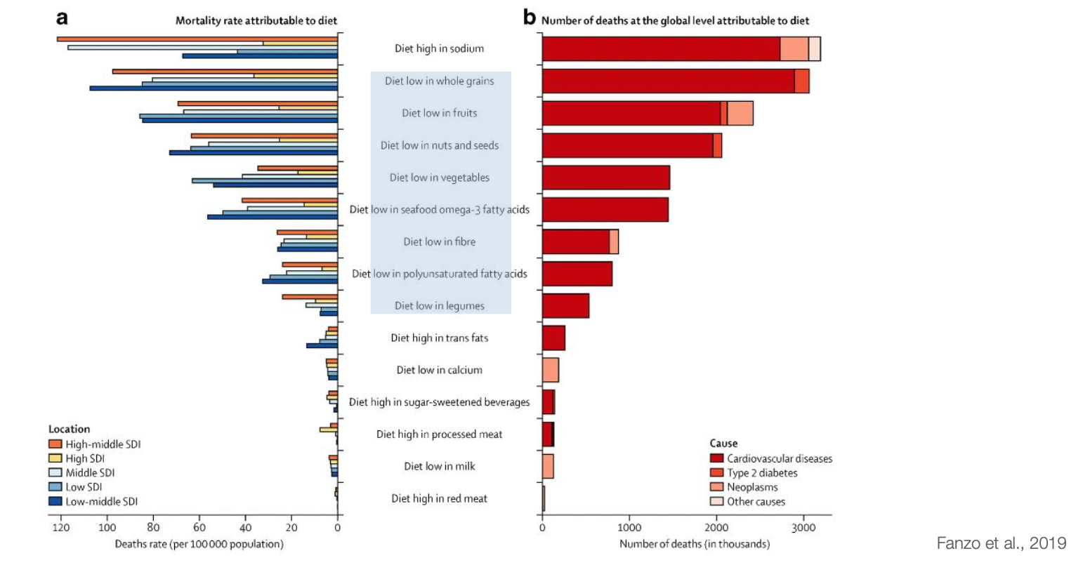


Diet related health problems

Slide 3

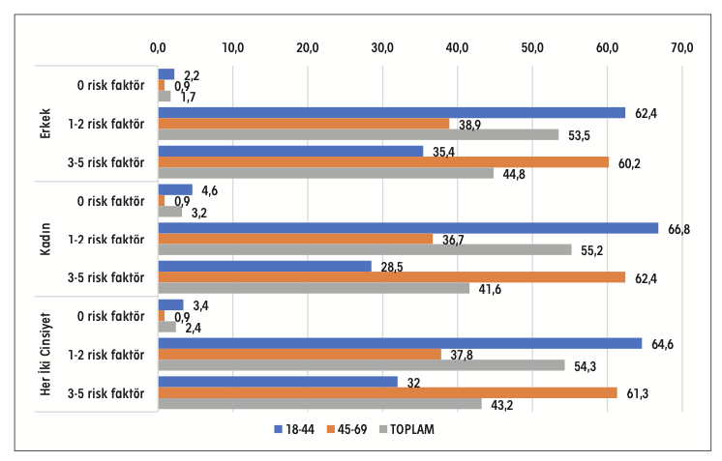
Diet related health problems
Risk factors
0
1-2
3-5
0
1-2
3-5
0
1-2
3-5
Men
Women
Total
Notes:
Türkiye Hanehalkı Sağlık Araştırması Bulaşıcı Olmayan Hastalıkların Risk Faktörleri Prevalansı
y Her gün sigara içme
y Meyve ve/veya sebzenin günde beş porsiyondan daha az tüketimi
y Haftada 150 dakikalık orta düzey veya eşdeğer etkinlikten daha düşük fiziksel aktivite
y Aşırı kilolu veya obez (BKİ ≥25 kg/m2) olma
y Yükselmiş kan basıncı (SKB ≥140 mmHg ve/veya DKB ≥90 mmHg) veya yüksek tansiyon için ilaç
kullanıyor olma

Slide 4
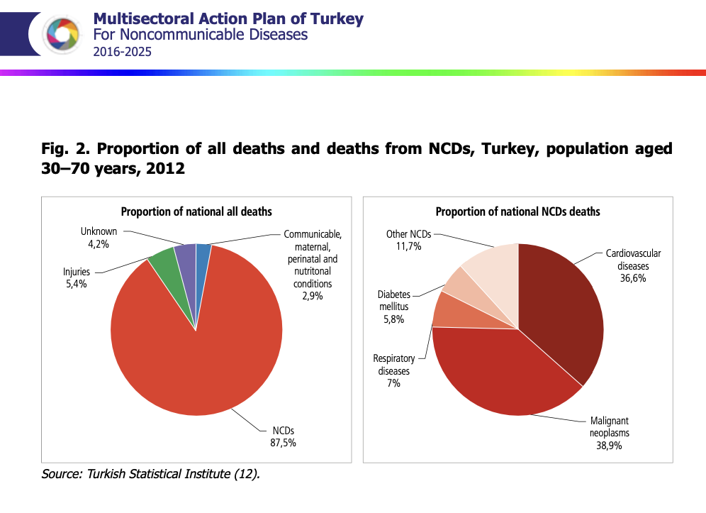
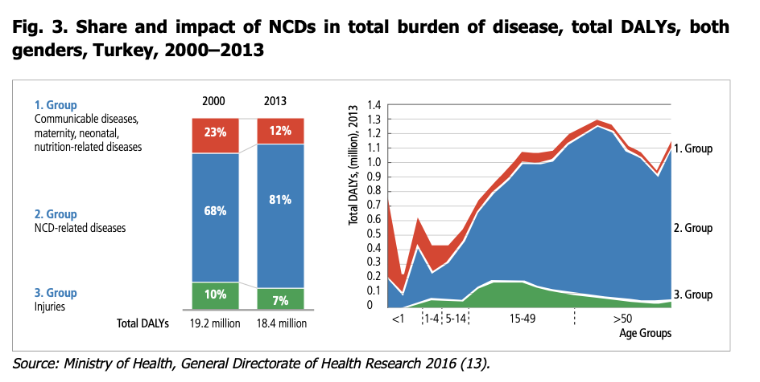
Diet related health problems
Türkiye
Notes:
1st rank in diabetes in Europe (%16)

Slide 5
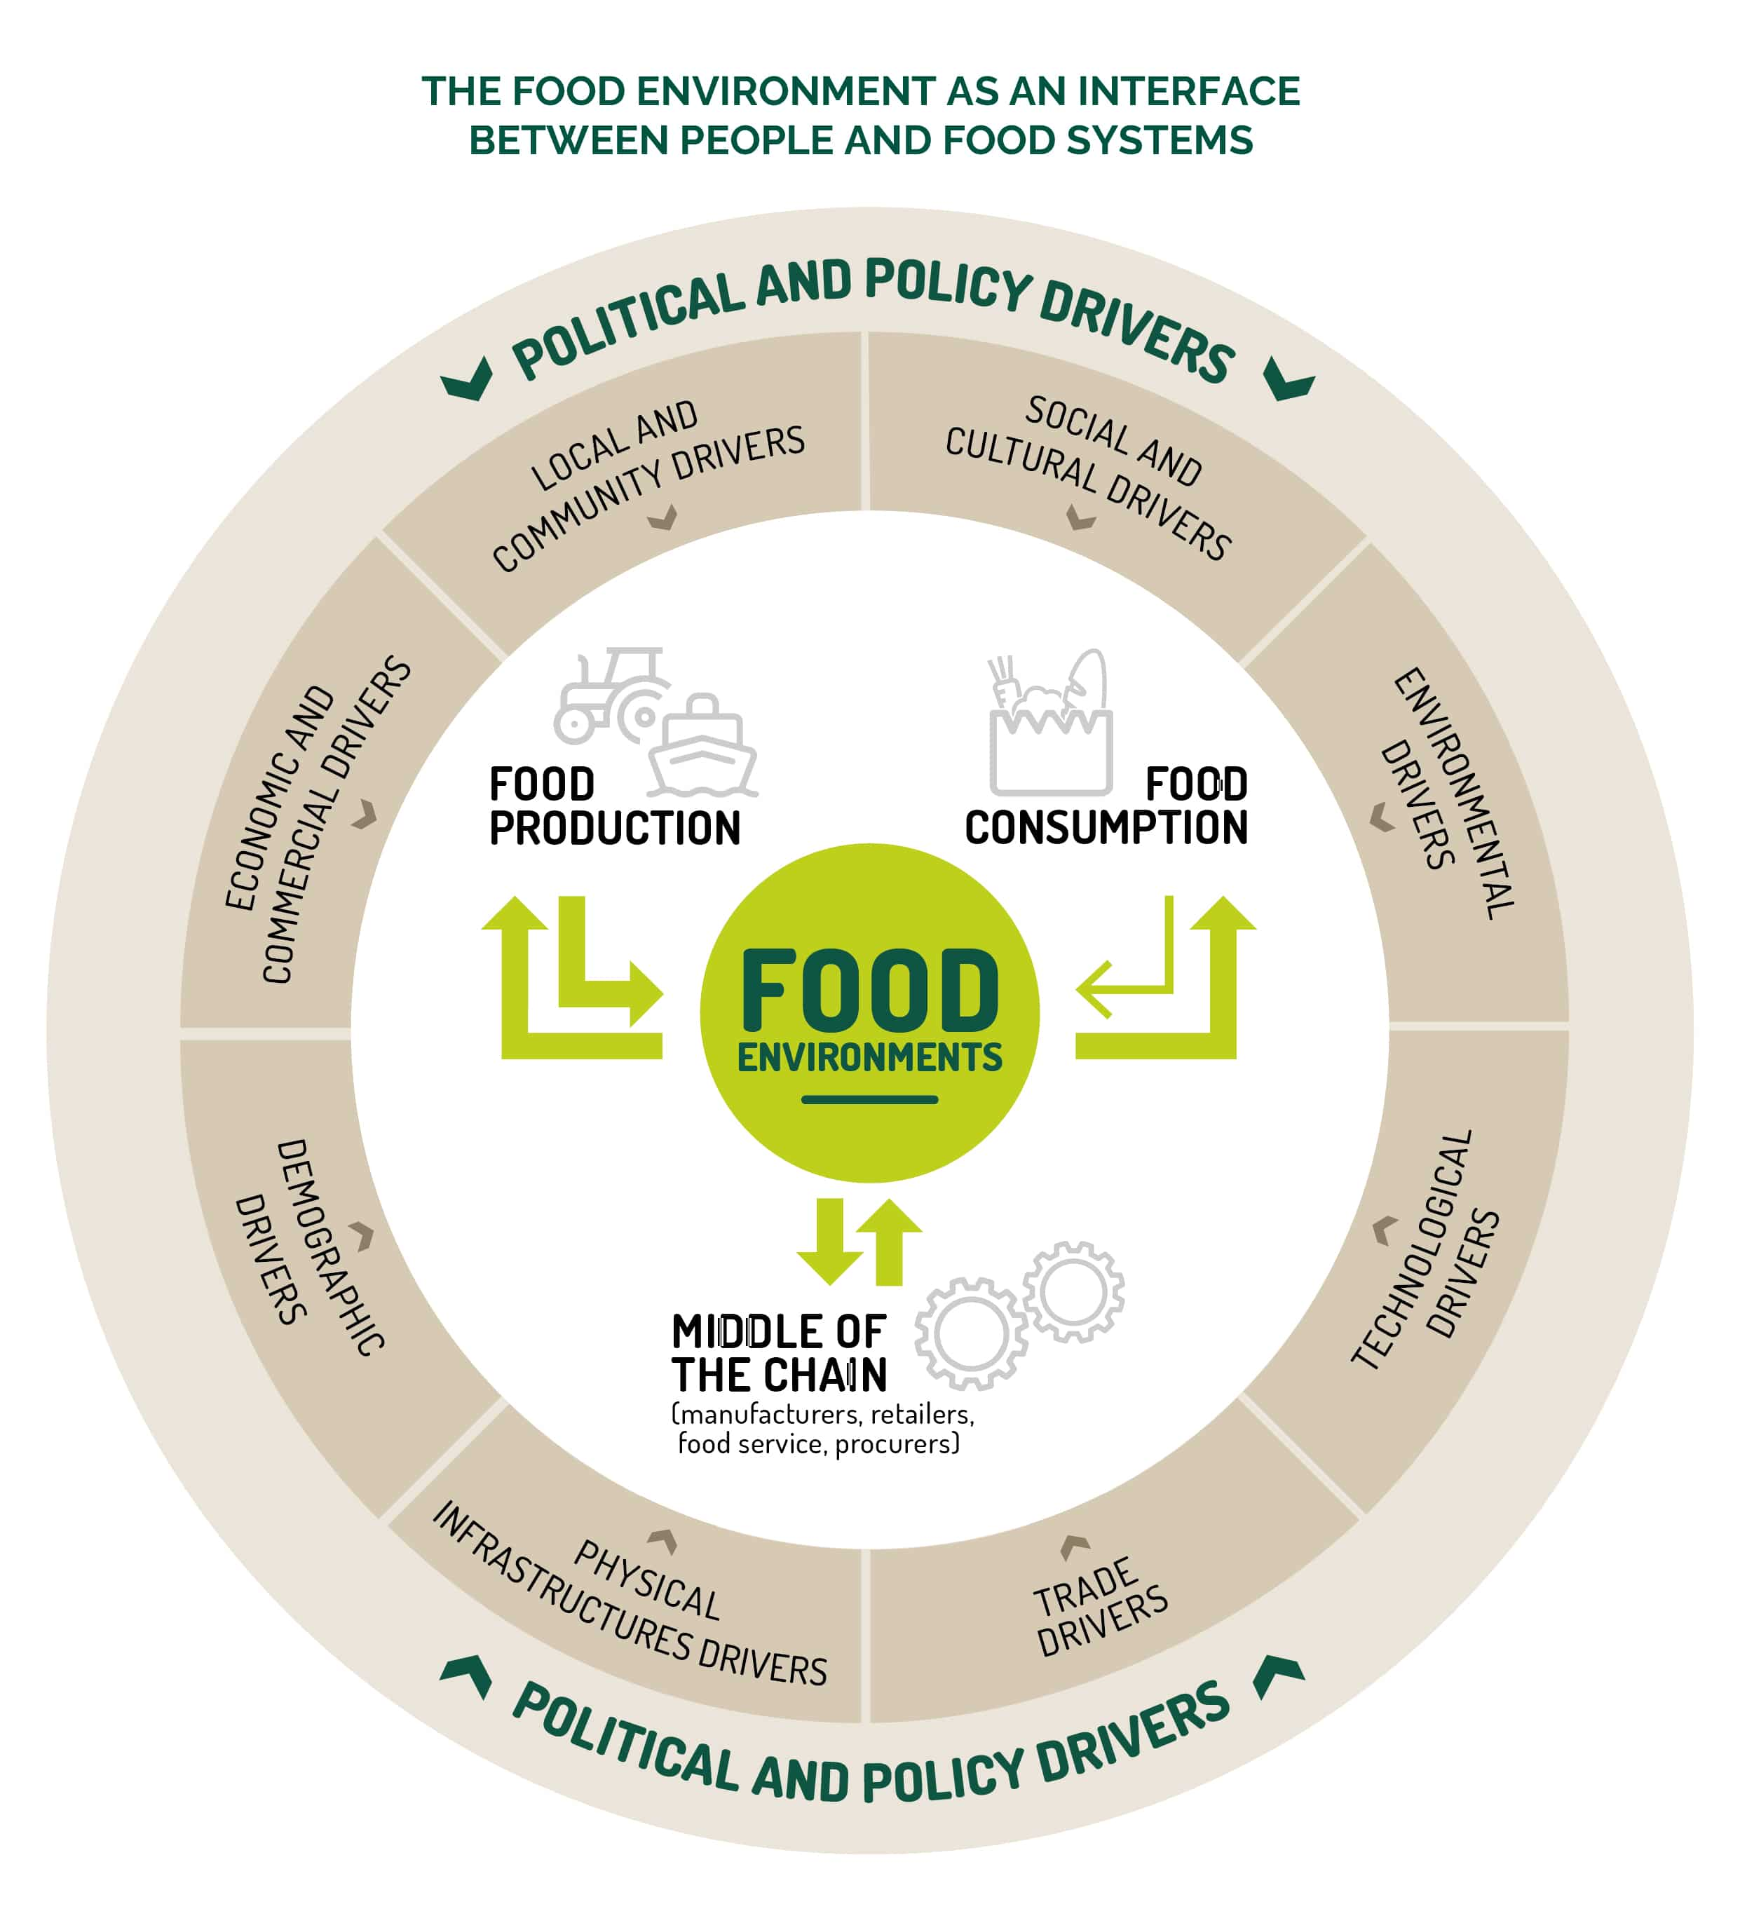
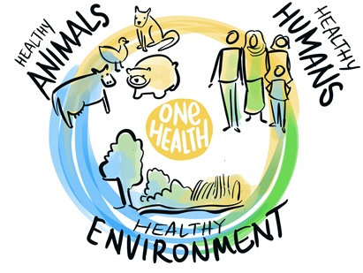
Not merely an individual issue
Food
https://www.who.int/news-room/events/detail/2023/05/31/default-calendar/epi-win-webinar-emerging-zoonotic-diseases-and-the-one-health-approach
https://epha.org/policy-briefing-i-discovering-the-role-of-food-environments-for-sustainable-food-systems/

Slide 6


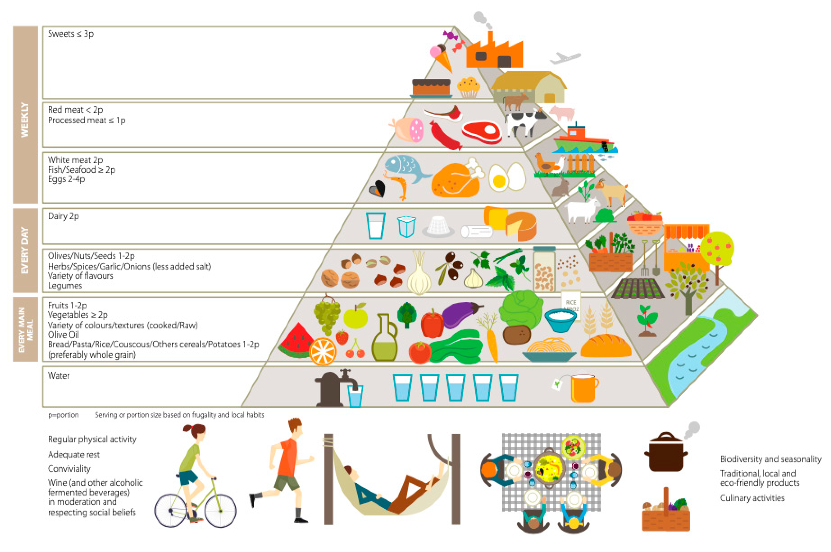








Mediterranean Diet (MD) Food service
Serra-Majem, L., Tomaino, L., Dernini, S., Berry, E. M., Lairon, D., Ngo de la Cruz, J., Bach-Faig, A., Donini, L. M., Medina, F.-X., Belahsen, R., Piscopo, S., Capone, R., Aranceta-Bartrina, J., La Vecchia, C., & Trichopoulou, A. (2020). Updating the Mediterranean Diet Pyramid towards Sustainability: Focus on Environmental Concerns. International Journal of Environmental Research and Public Health, 17(23), 8758. https://doi.org/10.3390/ijerph17238758
Notes:
Food service comprises the production of meals consumed outside the home, including consumers from all age groups and in different sectors. This service sector has evolved through the years, providing an increasing number of meals, which have been drifting away from the Mediterranean Food Pattern.
Diet related health problems,
Sustainable development goals

Slide 7
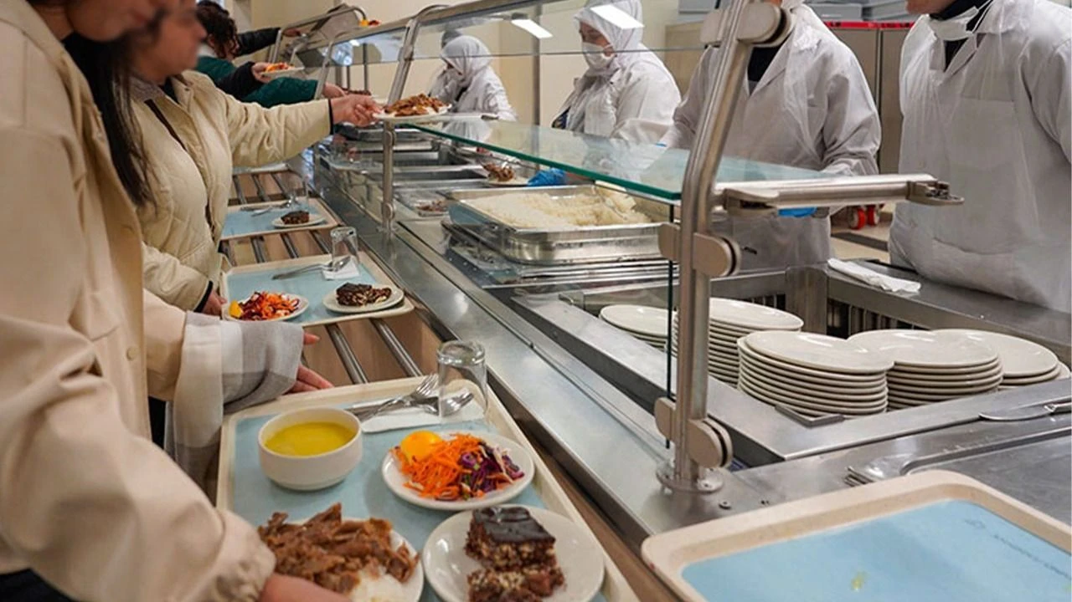
Not merely an individual issue
Role of the food service
Menu components
Large quantities
Standard portions
https://epha.org/policy-briefing-i-discovering-the-role-of-food-environments-for-sustainable-food-systems/Springmann, M., & Freund, D. (2022). Options for keeping the food system within environmental limits. Nature Food, 3(1), 4-14.

Slide 8
Not merely an individual issue
The Mediterranean Diet (MedD) is widely recognized as a health-promoting and sustainable dietary pattern.
Role of the food service
Diets with less impact on the environment
Sustainable diets
The Mediterranean diet
FAO. Biodiversity and Sustainable Diets: United Against Hunger (Rome). Rome 2010.
Vaz-Velho ML, Pinheiro R, Rodrigues AS. The Atlantic diet–Origin and features. International Journal of Food Studies. 2016;5(1).

Slide 9




University food service as a lab
Public health intervention
Consumer education
Behaviour change
Notes:
Food service is an important setting for public health interventions, educating consumers and modulating behaviours through the meals provided.
Prior research on eating habits has mainly focused on a single stakeholder - typically consumers - and on a narrow set of outcome variable
Studies reinforce that food services (FS) are ideal for fostering healthy eating habits [28] and the FS menu is a tool that identifies appropriate food availability and plays a leading role in offering healthy choices that promote healthy eat- ing habits. It may also be a useful tool in nutrition literacy and education [26, 29] (silva)

Slide 10


A different approach
Notes:
Although these studies provide important clues about the determinants of adherence to food offer, research has yet to address this issue using an integrative approach of multiple stakeholders (e.g., the consumers, food providers, decisors) across a set of different variables. Also, intervention initiatives, usually act only on the environment without strategies that efficiently engage all the stakeholders involved.

Slide 11





A different approach
Adequacy in menus
Variety in menus
Balance in the number of meals and meal distribution
High subjective quality
Protection of the nutritional value
High hygienic quality
Affordability
Menu planning
Standard recipe development
Purchasing
Storage
Preparation
Cooking
Service
Hygiene and food safety
Waste removal
Management and organisation
stakeholders

Slide 12


An integrative approach
Integrative approach of multiple stakeholders
Food environment + strategies to engage stakeholders
Notes:
Although these studies provide important clues about the determinants of adherence to food offer, research has yet to address this issue using an integrative approach of multiple stakeholders (e.g., the consumers, food providers, decisors) across a set of different variables. Also, intervention initiatives, usually act only on the environment without strategies that efficiently engage all the stakeholders involved.

Slide 13










A different approach
Social marketing strategies
Notes:
Social Marketing is one of the strategies, empirically verified, designed to promote change behavior, which contributions to health and well being of citizens are positively recognized by many. Establishing and managing long- term partnerships that include different groups of stakeholders - consumers, government, retailers and other players - are key elements in the application of mid and upstream social marketing to complex issues.

Slide 14
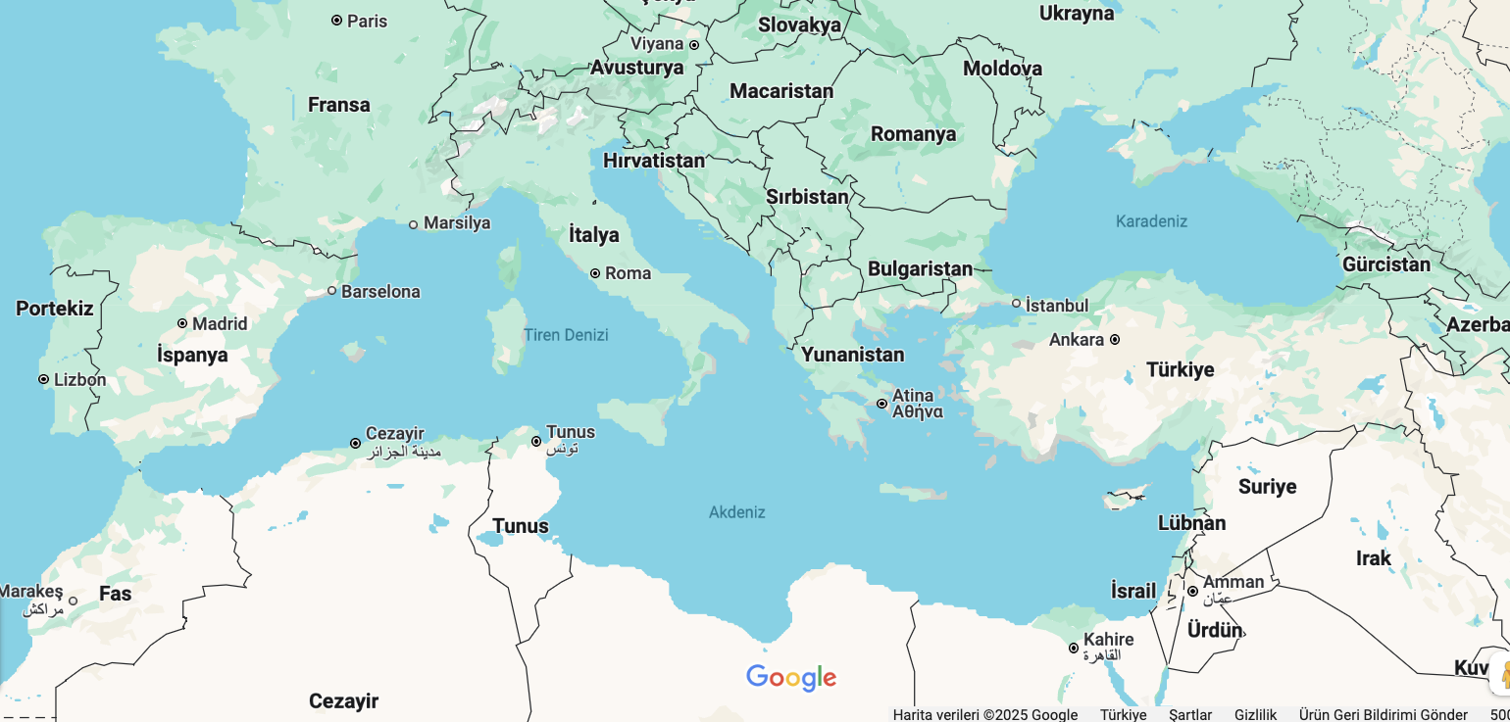






MedDietmenus4Campus aims to
Menu intervention with MD dishes – plant-based, seasonal, local
Social marketing strategies to engage stakeholders
Notes:
This project, developed in Portugal, Turkey, and Croatia, aims to identify the compliance of food service menus with the Mediterranean Diet in public high education institutes canteens, pinpointing opportunities to intervene, namely: 1) promoting changes in the food offer addressing proximity to the Mediterranean Food Pattern, creating, and offering plant- based meals, with seasonable and local food products and 2) developing tailored social marketing strategies to engaging stakeholders to encourage healthier and sustainable food habits

Slide 15
MedDietmenus4Campus will
define the characteristics of food service
develop an index to evaluate the compliance of menus with the MD
define priority stakeholders and methodology for engagement
evaluate perceptions, barriers and facilitators
develop a meal plan framework
develop a new “ MD student bag”
develop and use social marketing strategies
measure the impacts of the implemented strategies
Notes:
To achieve the objectives researches will: 1) develop and index to evaluate compliance of menus with the Mediterranean Diet; 2) based on personal interviews, define priority stakeholders and define methodology for engagement; 3) evaluate perceptions, barriers and facilitators through self-administered surveys and in-depth interviews; 4) develop of a 1- month meal plan framework; 5) develop tools concerning the concept premises to empower the catering employees and consumers to understand the proposed menu methodology; 6) develop a new food concept/product “student bag” (meal on the go) and test it for industry scale up; 7) use previous diagnose to develop social/emotional marketing strategies directed to stakeholders and consumers to achieve food behaviour change and 8) measure the impacts of the implemented strategies through a feasibility test.

Slide 16



MedDietmenus4Campus addresses
Sustainable Development Goals for 2030
Notes:
The project's main ambition is to change the food service paradigm,
by creating and implementing a new healthy and sustainable food service concept that truly complies with the Mediterranean diet,
as well as solutions that comply with consumers new needs, and also developing and implementing strategies that engage all the stakeholders with this concept.
We expect to create the reference in terms of food offer that will be demanded by consumers of the next generations and the standpoint to inspire the other food service sectors/ settings achieving an effective and sustainable food offer change and positively influence food service consumers’ food pattern towards Mediterranean recommendations, while addressing the Sustainable Development Goals (3 - good health and 12 - responsible consumption and production; 17 - partnerships for the goals).

Slide 17

PRIMA/0009/2022
Notes:
Topic 2.3.1-2022 (RIA) Enabling the transition to healthy and sustainable dietary behaviour

Slide 18


Notes:
. It gathers a team comprised of nutrition experts on public health and food service, food technologists, gastronomy experts, psychologists, and marketers, with a vast experience and professional skills.

Slide 19
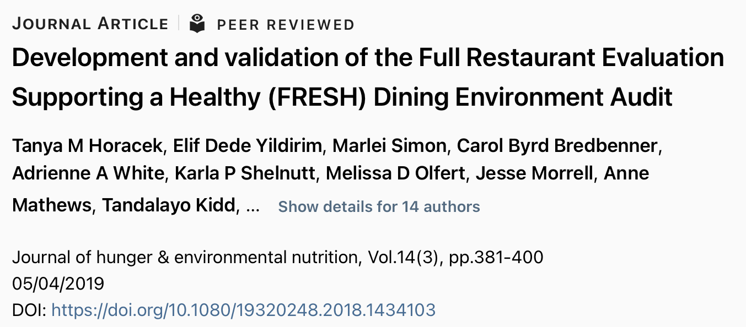
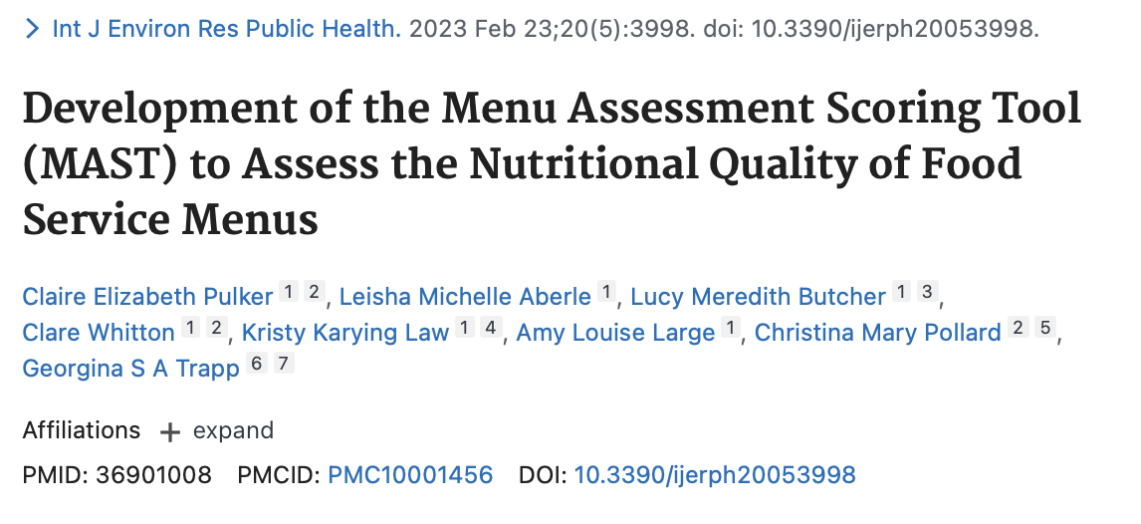
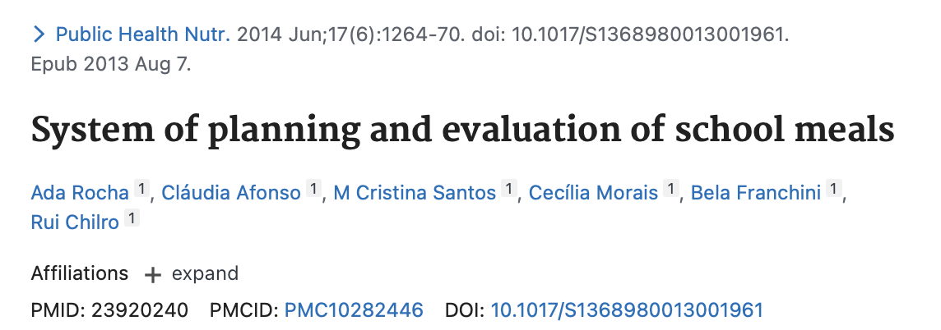
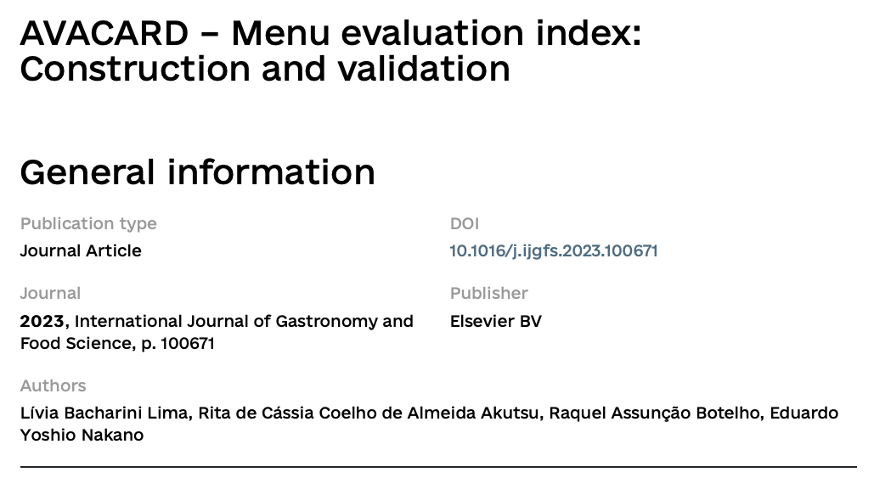
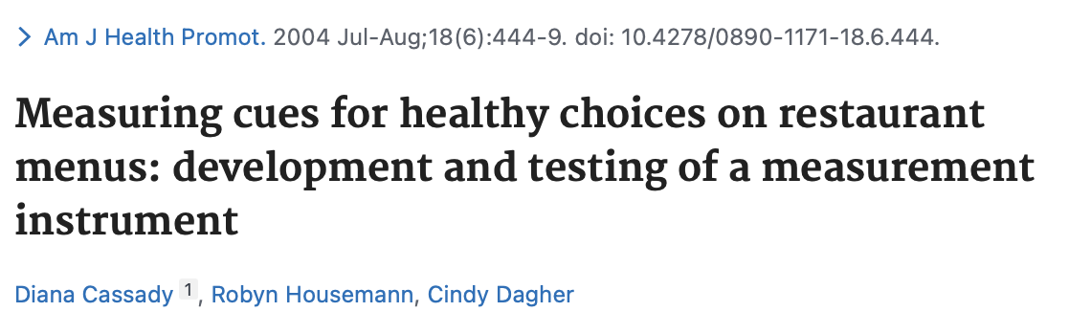
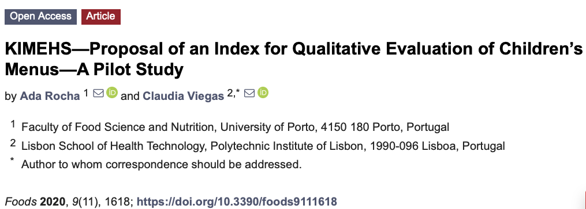
1. define the characteristics of food service
2. develop an index to evaluate the compliance of menus with the MD
No index available on MD adherence in food service
Except KIMEHS (for children)

Slide 20
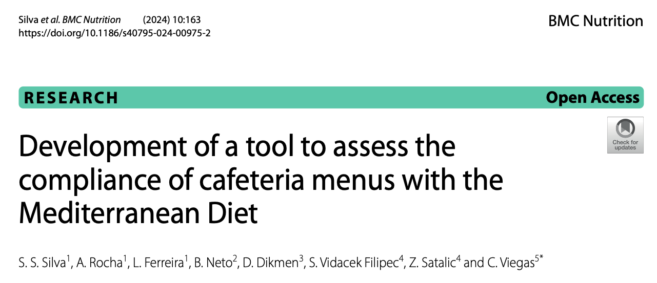
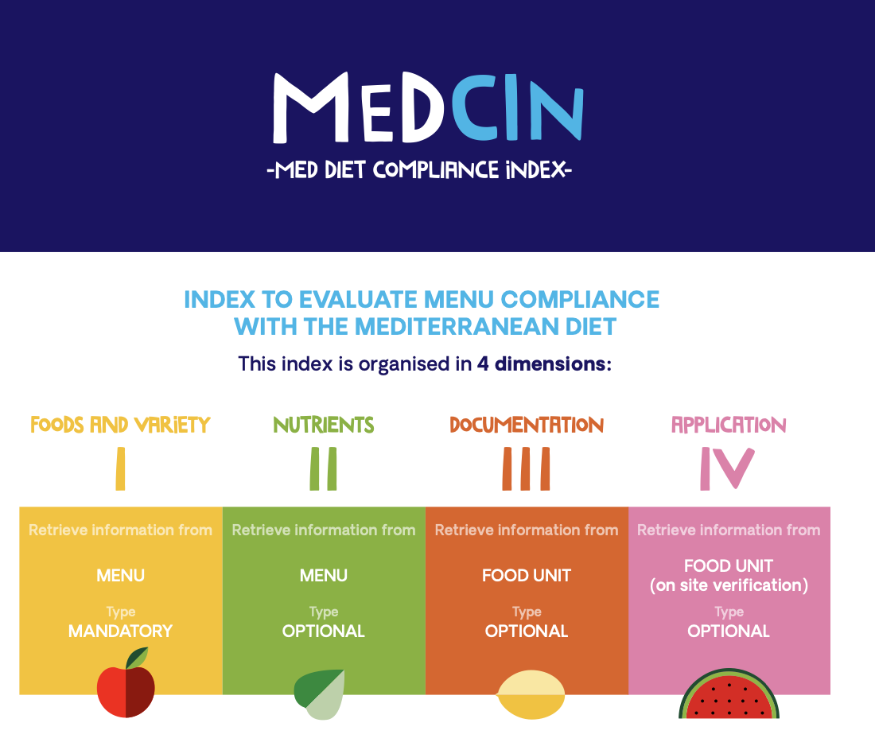
1. define the characteristics of food service
2. develop an index to evaluate the compliance of menus with the MD
52 menus (24 PT, 14 TR, 14 HR)
Notes:
52 menus (24 portugal, 14 tr, 14 crotia)
September 2023 to June 2024.
4.65±4.2 for all menus (−7 to 13.5 )

Slide 21
1. define the characteristics of food service
2. develop an index to evaluate the compliance of menus with the MD
MD Key points
Indexes on individual adherence to MD
Indexes on menu assessment
Notes:
Many indexes of adherence to the MD have been devel- oped to understand how individuals’ practices align with this dietary pattern [15] (silva) The MeDCIn tool is relevant because although several indices assess individual adherence to DM, few are dedi- cated to evaluating menus [21–26, 47]. From these tools, only the KIMEHS assesses menus in the context of MD, but for children [25].
MD key points.
2. Existing indexes on individual adherence to the MD. 3. Existing indexes on menu assessment
Dimension II
Ratio monounsaturated/saturated fat > 2
Cholesterol < 90 mg
Fibre > 7,5 g
Salt < 1,5 g
The authors considered 30% of the recommended daily value for monounsaturated and saturated fat, cholesterol, and fibre as adequate for main meals (lunch or dinner) [44, 45].

Slide 22
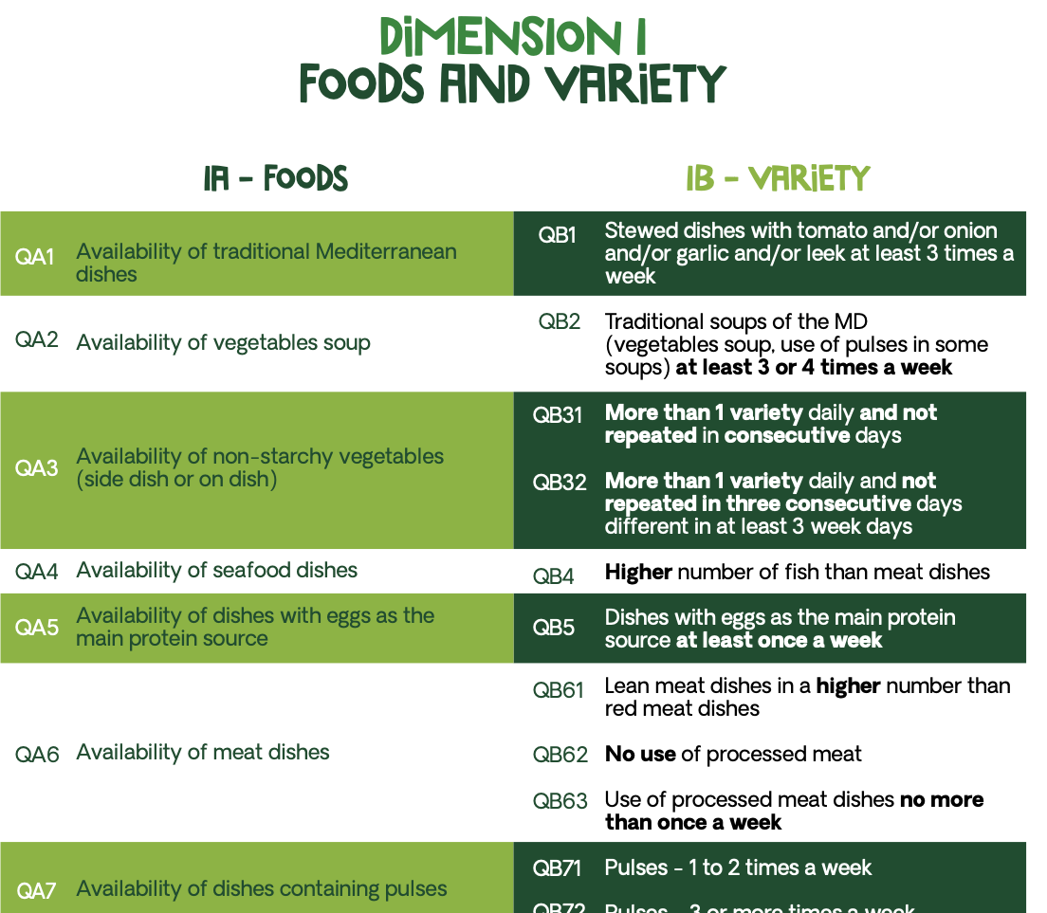
Notes:
The wine was not considered because it is not intended to be promoted in public food services and due to the conflicting outcomes of alco- hol consumption [41–43],
Dairy products were not considered because in Portugal it is not usual to con- sume these foods at lunchtime, and in Croatia are also a staple for breakfast and snacks, but not for lunch.
New
Although egg is an an important part of the MD, it is only mentioned in some studies assessing adherence to the MD [54–57].
Seasonal products and Mediterranean dishes and soups aren’t included in these individual MD adherence tools [34], but as a tool to evaluate menus, authors believe rel- evant to include this information.

Slide 23
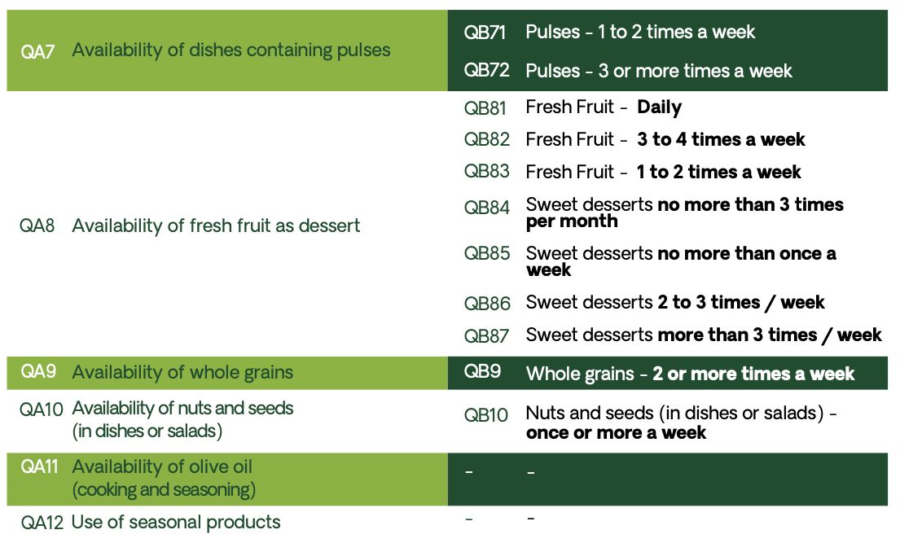
Notes:
Scoring methods
Foods/criteria with higher importance in meddiet – a higher number of seafood dishes scores two points, while the opposite penalizes two negative points.
N/A option was available for whole grains, olive oil and seasonal products

Slide 24
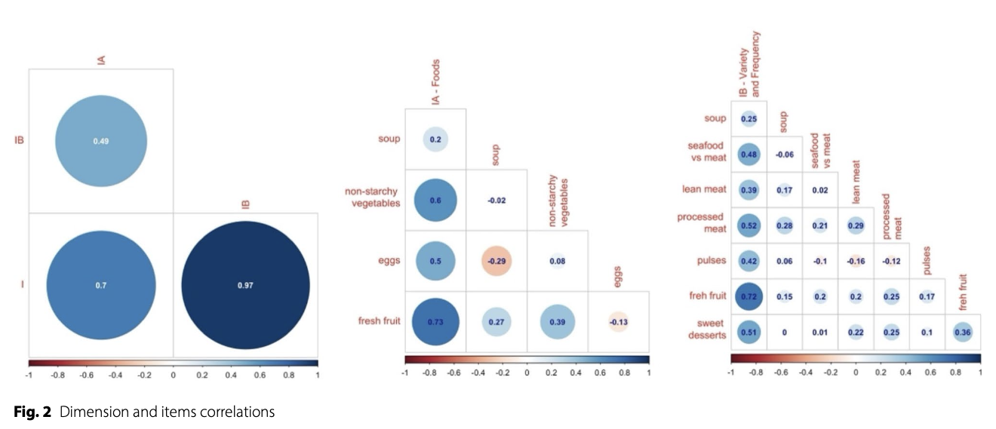
1. define the characteristics of food service
2. develop an index to evaluate the compliance of menus with the MD
High internal consistency (Cronbach’s alpha = 0.88)
High inter-rater reliability (Cohen’s Kappa = 0,92)
Notes:
Spearman correlation was used to evaluate the dimensions and item correlations of the developed index. Statistical significance was considered at p < 0.05.
According to the results, the MeDCIn total score has a high internal consistency, evidenced by a Cronbach’salpha coefficient of 0.88 (>0.80), indicating that the items consistently measure what they are intended to measure [49, 50]. The high inter-rater reliability, evidenced by a Cohen’s Kappa of 0,92 (>0,75), indicates that the MeDCIn is consistent and reliable, with a high level of agreement between researchers [51].
The results of internal consistency and inter-rater reliability are high, demonstrating that the MeDCIn has reproducibility, which proves its potential to be used by different users to assess the degree of com- pliance of menus with the key points of the MD.

Slide 25
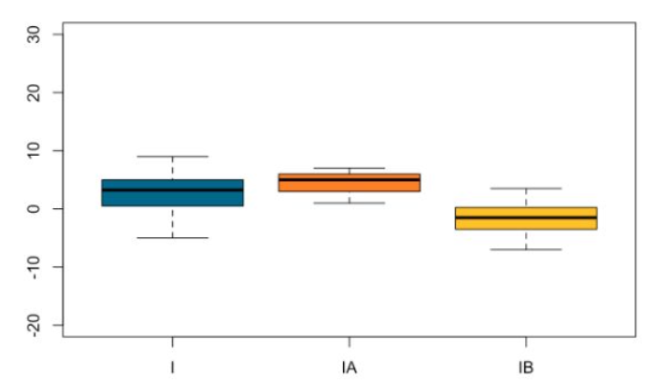
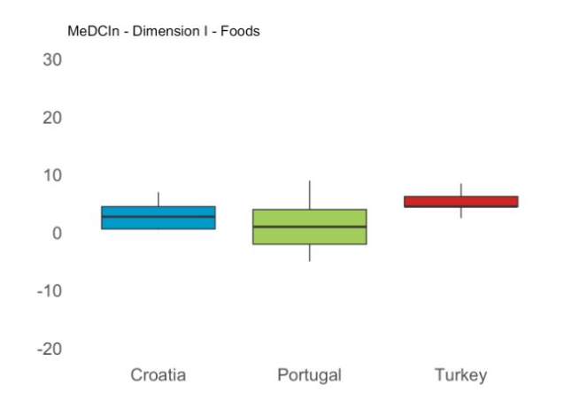
1. define the characteristics of food service
2. develop an index to evaluate the compliance of menus with the MD
Studies in university students:
low intake of vegetables, fruit, pulses, whole grains and dairy products,
high intake of foods high in fat, sugar, and salt
low adherence to the MD
Hafiz AA, Gallagher AM, Devine L, Hill AJ. University student practices and perceptions on eating behaviours whilst living away from home. Int J Educa- tional Res. 2023;117:102133.
Vilarnau C, Stracker DM, Funtikov A, da Silva R, Estruch R, Bach-Faig A. World- wide adherence to Mediterranean Diet between 1960 and 2011. Eur J Clin Nutr. 2019;72(Suppl 1):83–91.
Notes:
Overall low compliance
Opportunity to implement MD intervention
4.65±4.2 for all menus (−7 to 13.5 )
The subdimension IA - food availability, varied between 1.0 and 7.0 with an average of 4.87 ± 1.2, indicat- ing a moderate availability of foods characteristic of the MD.
The sub-dimention IB - variety and frequency of foods offered, varied between −8.0 and 6.5, with an average of 0.22±3.4, indicating a limited variety, low frequency of key food groups and high-frequency of food groups that should be limited, which is the factor that most influ- ences the dimension I of the MeDCin (r=0.97).

Slide 26






1. define the characteristics of food service
2. develop an index to evaluate the compliance of menus with the MD
Notes:
SEAFOOD 14.3
DISHES WİTH EGG AS THE MAİN SOURCE 0
NUTS AND SEEDS 7.1
FRESH FRUIT AS DESSERT 57.1
Availability of olive oil (cooking and seasoning): 85.7%
Whole grains: %92.9

Slide 27




1. define the characteristics of food service
2. develop an index to evaluate the compliance of menus with the MD
Notes:
NON STARCH VEGGİES
NOT REPEATED CONSECUTİVELY 7.1
MORE FİSH THAN MEAT 0
EGGS AT LEAST 1/WEEK 0
MORE LEAN MEAT 0
FRUİT DAİLY OR 3 OR MORE/WEEK
SWEET DESSERT NO MORE THAN 1/WEEK 42.9
--------
PULSES 1-2 WEEK 71.4
WHOLE GRAİNS 78.6

Slide 28
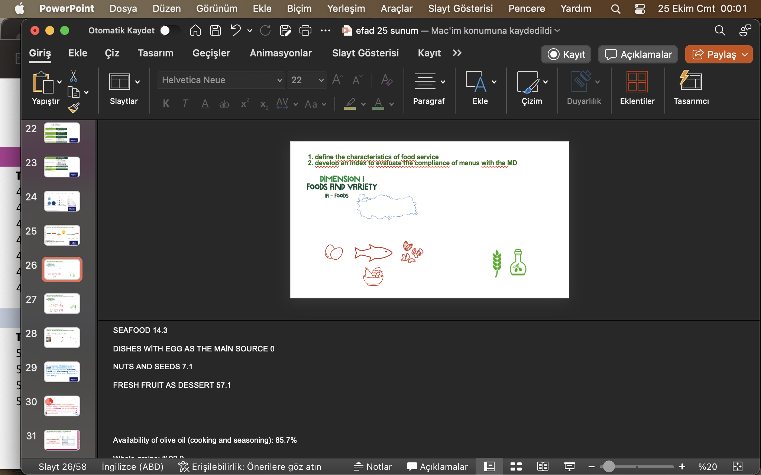






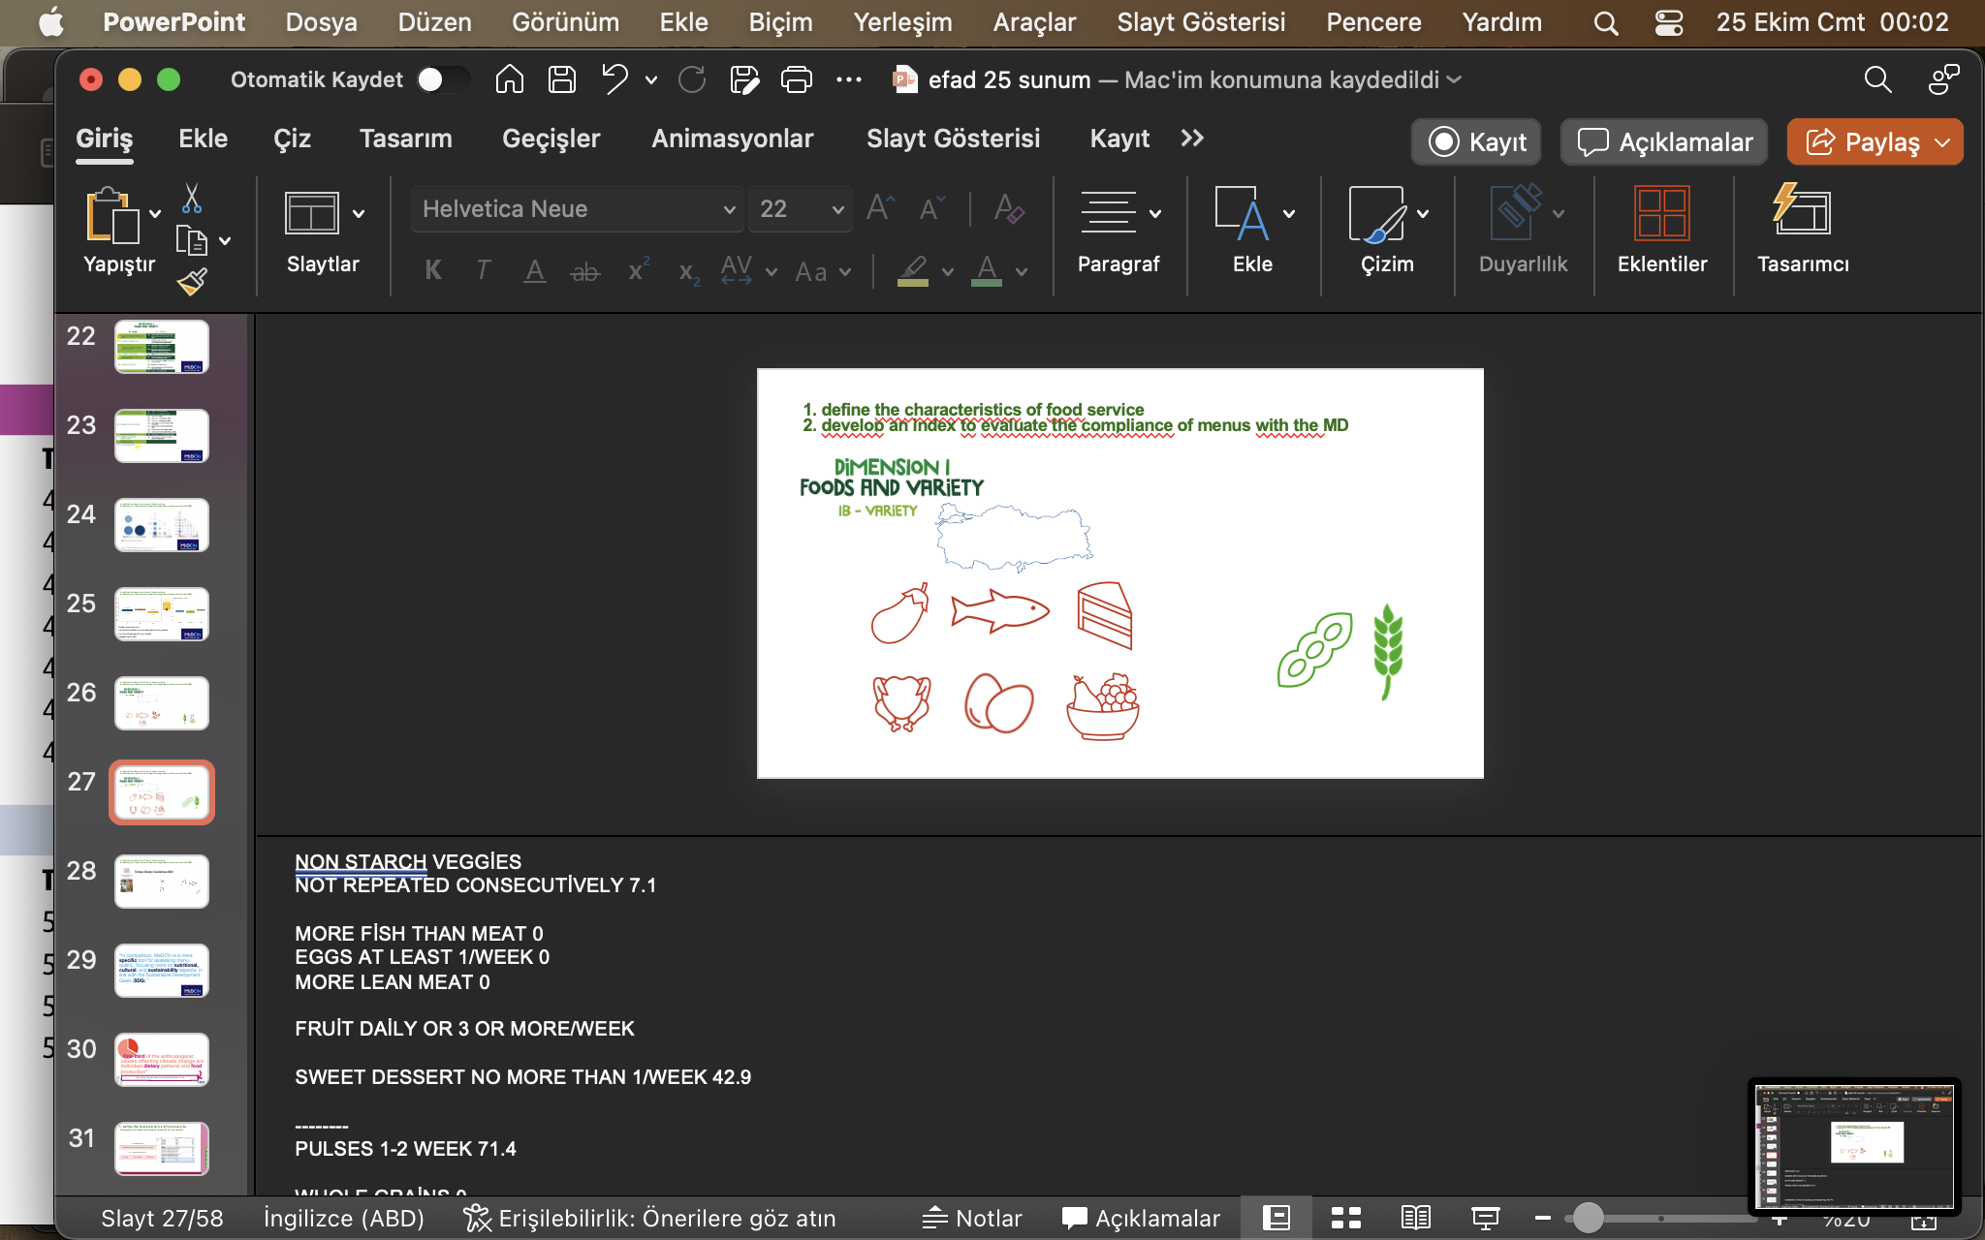
1. define the characteristics of food service
2. develop an index to evaluate the compliance of menus with the MD
Consumption should be increased:
Dietary fiber
Vitamin D sources and sun exposure
Türkiye Dietary Guidelines 2022
Consumption should be decreased:
Saturated fat, trans fat, cholesterol
Salt
Sugar
Processed foods

Slide 29
“In comparison, MeDCIn is a more specific tool for assessing menu quality, focusing more on nutritional, cultural, and sustainability aspects, in line with the Sustainable Development Goals (SDG).”
Notes:
Broader, detailed and practical
Can be quickly and pracitaclly used by dietitians, nutritionists, food techinicians
And not just for once, it will make routine monitoring easy

Slide 30


“One-third of the anthropogenic causes affecting climate change are individual dietary patterns and food production”
Calculation of water and carbon footprint for the menus
Madalı, B., Karabulut, Ö. F., Öztürk, E. E., Parlak, L., Erdinç, A. Ş., & Dikmen, D. (2021). Toplu beslenme hizmeti veren bir kuruluşta sunulan menünün sera gazı emisyon ve su ayakizi düzeylerinin mevsimlere göre değerlendirilmesi. Beslenme ve Diyet Dergisi, 49(1), 5-14.

Slide 31
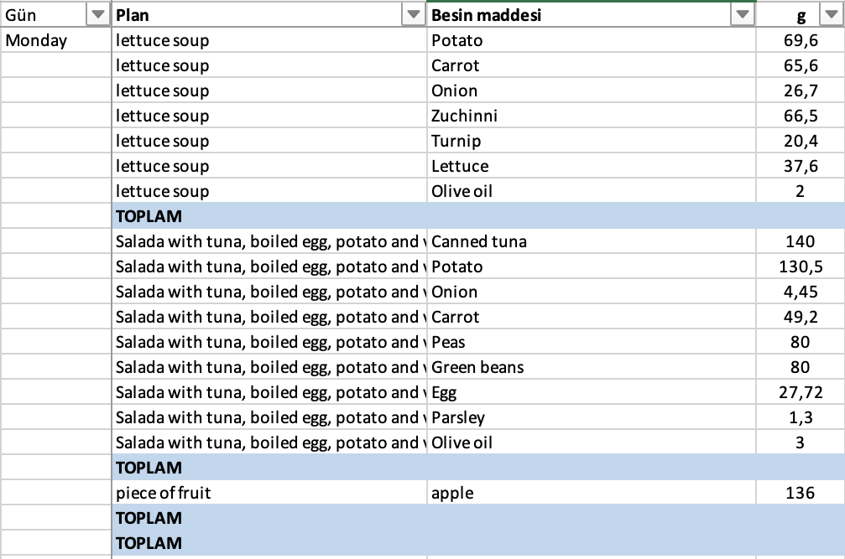

1. define the characteristics of food service
Calculation of water and carbon footprint for the menus
10 canteens
2-week (10 working days) menus
1-4 course menus
Crotia | Portugal | Türkiye

Slide 32




1. define the characteristics of food service carbon footprint of the menus
Total greenhouse emissions
Life Cycle Assessment (LCA) approach (ISO 14040) - from raw material to disposal
Greenhouse gas emission in kilograms of CO² equivalent
S. Clune et al. / Journal of Cleaner Production 140 (2017) 766e783

Slide 33
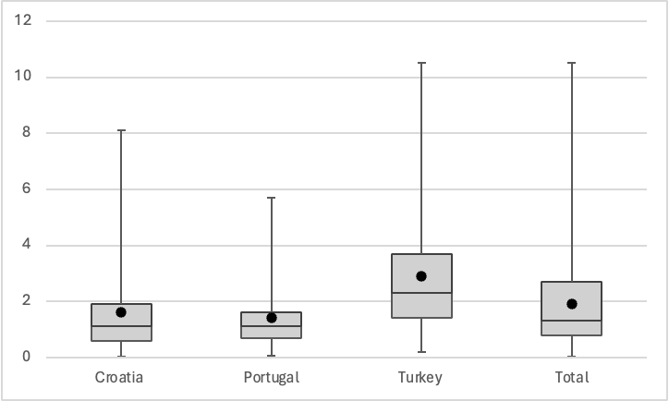
1. define the characteristics of food service carbon footprint of the menus
Total 1.9 ­± 1.8 kg CO²-eq
Türkiye 2.91 ­± 2.13 kg CO²-eq
Portugal 1.42­ ± 1.26 kg CO²-eq
Notes:
1,4 kg CO²-eq/person and day
Acceptable climate impact. Of food according to eat lancet commission

Slide 34
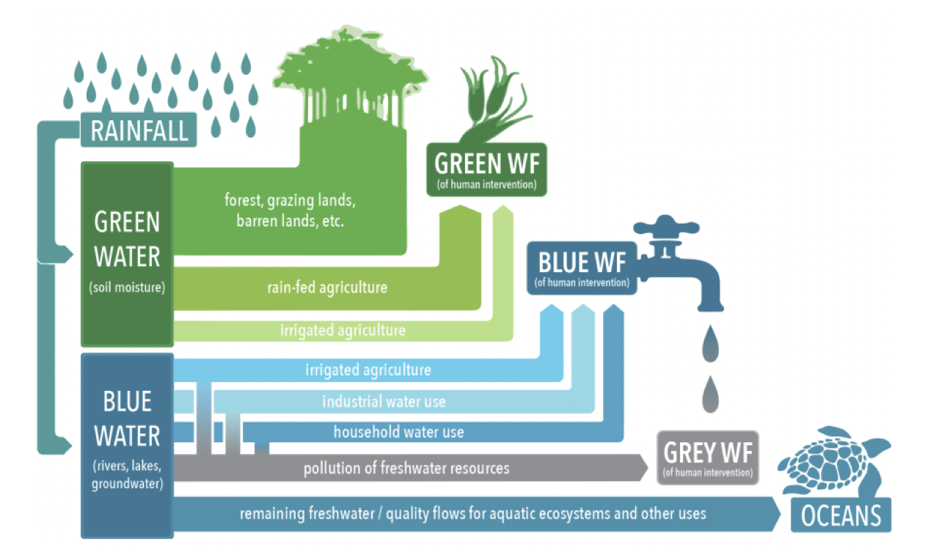
1. define the characteristics of food service carbon footprint of the menus
A product's water footprint
(virtual water content)
Sum of the water footprints of each of the production stages per product unit (usually m³ /ton)
Water Footprint Network
LCA approach (Life Cycle Assessment)
Values for fish were not available, extracted from Willett 2019
Mekonnen, M. M., & Hoekstra, A. Y. (2011). The green, blue and grey water footprint of crops and derived crop products. Hydrology and earth system sciences, 15(5), 1577-1600.
Tha Glacgow Declaration for fair water footprints, Towards Fair Water Footprints: Understanding the water footprints of the Global North and dependency on water use in the Global South , Adapted from WWF, AfDB (2012). Africa Ecological Footprint Report 2012

Slide 35
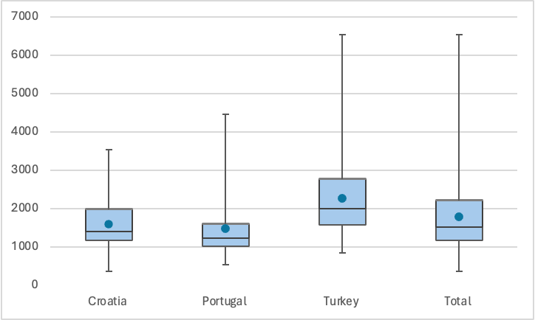
1. define the characteristics of food service water footprint of the menus
1785.411 ­± 909.3 m³/ton
Türkiye 2271.90 ­± 1016.11 m³/ton
Portugal 1485.46 ­± 767.28 m³/ton

Slide 36








1. define the characteristics of food service menu components - footprint
High carbon and water footprint
Low carbon and water footprint

Slide 37



1. define the characteristics of food service menu components - footprint
Location
Culture&Habits
Availability
Number and variety of menu components

Slide 38





1. define the characteristics of food service menu components - footprint
Crotia | Portugal | Türkiye

Slide 39
1. define the characteristics of food service
menu components - footprint
New chapter: Sustainable Nutrition
Why sustainable nutrition?
What is sustainable nutrition?
Mediterranean diet
Sustainable agriculture for sustainable nutrition
Recommendations for sustainable nutrition
Recommendations for food groups
Sustainable shopping recommendations
Seasonal consumption recommendations
Turkish cuisine and sustainability

Slide 40

3.define priority stakeholders and methodology for engagement
Possible stakeholders listed by researchers
Interviews with possible stakeholders
Finalised list
National characterization of food service in HEIs
Notes:
Stakeholders are listed by each teams – revised by the stakeholder interviews
The first task involves the development of a stakeholder engagement model, in the AA1000 framework. With interviews with institutional actors and service providers, the team identifies priority stakeholders and defines methodologies for their engagement in the different phases of the project
Findings allowed us to conclude that, given the expected differences between sociocultural, economic and political landscapes between countries, priority stakeholders and their levels of dependence and influence, are quite different per country. Moreover, differences between in-campus operational management practices of food services also lead to divergent perceptions regarding who should be considered as key stakeholders

Slide 41
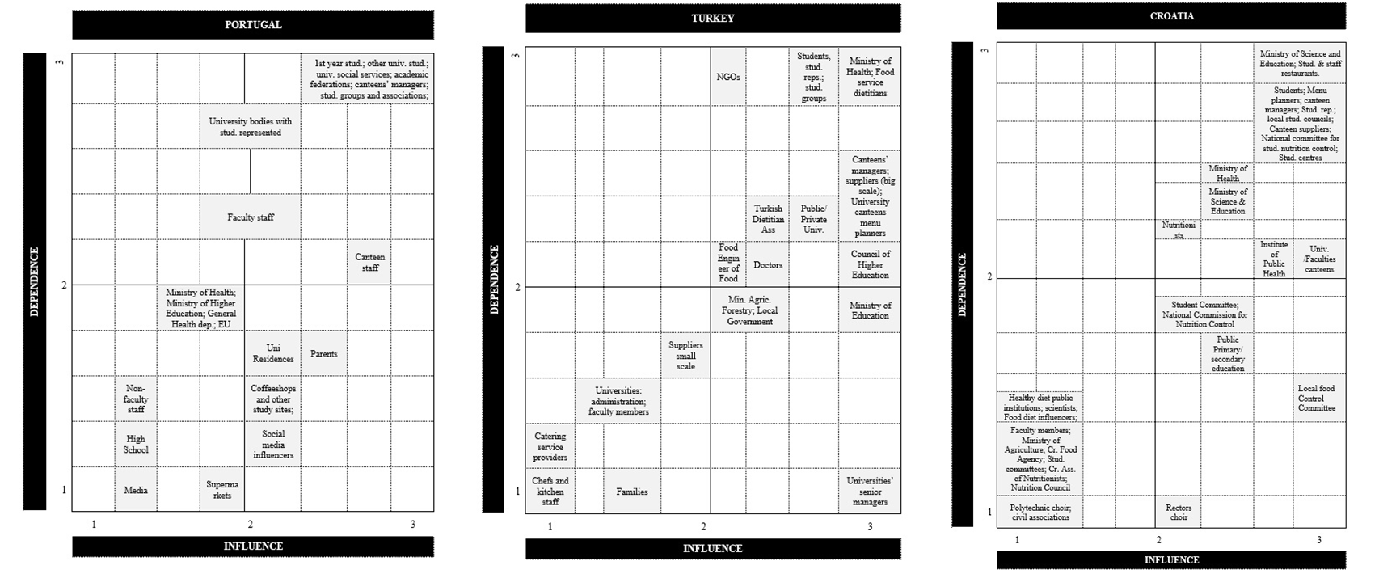
3. define priority stakeholders and methodology for engagement
Notes:
The biggest difference we can highlight from this phase was the higher number of stakeholders referred to at the upper level in Turkey and Croatia when compared to Portugal. In Portugal, there is a greater reference to several different stakeholders within the HEIs.
The cross-comparative analysis of the data retrieved from the three countries revealed that certain key stakeholders are recognized across the three contexts, specifically students, HEIs, canteens and nutritionists/dietitians. However, it was found that the reality of the legal/political and social framework of the three countries significantly shaped the identification and prioritization of specific stakeholders. For example, in Croatia, there is a greater centralization of operations in the Ministry of Science and Higher Education while in Turkey, this falls into the Council of Higher Education.
Findings revealed that is not enough to create a single stakeholder engagement model throughout the social marketing plan from a more global perspective, as if one solution fits all. This study highlights the importance of designing glocal social marketing strategies, with embedded models of stakeholder engagement practices, which implies standardizing the tools and practices that are possible to homogenise and adapting what is necessary to thrive success in different national realities.

Slide 42
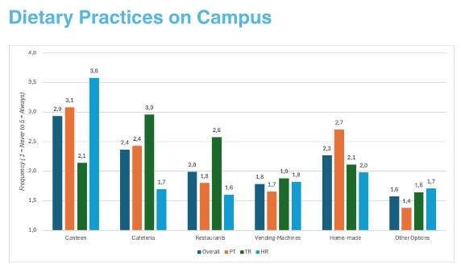
4.evaluate perceptions, barriers and facilitators
1614 HEI university students
Living with family (47.7%)
Questions:
Sociodempgraphics
Heath status
Dietary practices
Perceptions of food service in campus (NET promotion score, willingness to pay: YES)
MD adherence (PrediMed)
MD knowledge
Project Outcomes I Campus Menu and Perception Assessment, Inês Manuel Brito & Marília Prada, 4 July 2025, Ankara
Notes:
Turkey presented higher scores for all categories assessed, with cafeteria being the most frequent choice, followed by restaurants nearby campus, canteen and home-made food supply.
Congruent with the aims of the current study, the difference in canteen usage across countries was specifically examined by conducting ANOVAs with Country (3: PT, TR, HR) as between-factor with canteen frequency usage as the dependent variable. We found a main effect of the country, F(2, 1598) = 525.92, p < .001, such that Turkish students showed higher frequency of using the canteen and cafeteria services, followed by Portugal, with lower scores for Croatia.
The results showed a main effect of the country, F(2, 1611) = 127.87, p < .001, with Portugal showing better perception of university canteens in comparison to Croatia and Turkey. Critically, the students from Turkey indicated the worst perception of canteens, all p < .001.
Turkey using more, perceiving worse
Country-based differences were found, F(2, 1606) = 6.08, p < .001, with Croatian students presenting the highest probability to promote campus canteens, followed by Portuguese students and then Turkish students (all ps < .001).
Final net promoter score: Portugal -37,8 / Croatia -18,7 / Turkey -78,2
NPS between -100 and 0 are in the critical zone of high risk of widespread dissatisfaction; however there are no previous studies using NPS to evaluate cafeterias. But since detractors are much higher than promoters, we have a problem here. It would be interesting to understand who these detractors, passives and promoters are according to dietary practices on campus.
Notably, the students are willing to pay more for better food and services at the campus canteens, with above-chance proportions (M = 0.59, SD = 0.49, p < .001). Croatian students (M = 0.80, SD = 0.40) showed increased availability to pay more in comparison to Portuguese (M = 0.47, SD = 0.50) and Turkish (M= 0.48, SD= 0.50) ones, F(2, 1602) = 92.20, p< .001, which did not differ (p = .933).
Regarding gender (women vs. men), we observed significant differences for all variables. Specifically, women reported using the canteen (M = 4.66, SD = 2.24) more frequently than men (M = 4.24, SD = 1.70), t(1561) = -3.50, p < . 001, d = 2.107. However, women evaluated the food offer and service (M = 3.45, SD = 0.86 and M = 3.04, SD = 1.02) more negatively than men (M = 3.57, SD = 0.75 and M = 3.25, SD = 0.92), t(1573) = 2.61, p < . 001, d = 0.827 and t(1573) = 3.74, p < . 001, d =0.990, respectively.

Slide 43
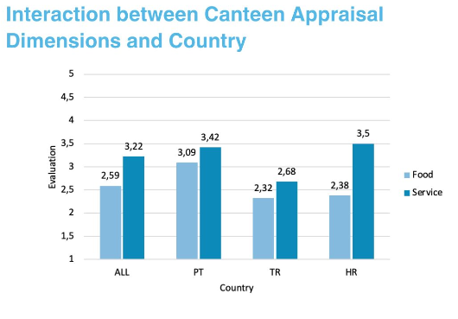
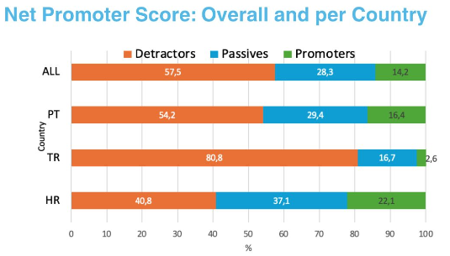
4.evaluate perceptions, barriers and facilitators
Project Outcomes I Campus Menu and Perception Assessment, Inês Manuel Brito & Marília Prada, 4 July 2025, Ankara
Notes:
Turkey presented higher scores for all categories assessed, with cafeteria being the most frequent choice, followed by restaurants nearby campus, canteen and home-made food supply.
Congruent with the aims of the current study, the difference in canteen usage across countries was specifically examined by conducting ANOVAs with Country (3: PT, TR, HR) as between-factor with canteen frequency usage as the dependent variable. We found a main effect of the country, F(2, 1598) = 525.92, p < .001, such that Turkish students showed higher frequency of using the canteen and cafeteria services, followed by Portugal, with lower scores for Croatia.
The results showed a main effect of the country, F(2, 1611) = 127.87, p < .001, with Portugal showing better perception of university canteens in comparison to Croatia and Turkey. Critically, the students from Turkey indicated the worst perception of canteens, all p < .001.
Turkey using more, perceiving worse
Country-based differences were found, F(2, 1606) = 6.08, p < .001, with Croatian students presenting the highest probability to promote campus canteens, followed by Portuguese students and then Turkish students (all ps < .001).
Final net promoter score: Portugal -37,8 / Croatia -18,7 / Turkey -78,2
NPS between -100 and 0 are in the critical zone of high risk of widespread dissatisfaction; however there are no previous studies using NPS to evaluate cafeterias. But since detractors are much higher than promoters, we have a problem here. It would be interesting to understand who these detractors, passives and promoters are according to dietary practices on campus.
Notably, the students are willing to pay more for better food and services at the campus canteens, with above-chance proportions (M = 0.59, SD = 0.49, p < .001). Croatian students (M = 0.80, SD = 0.40) showed increased availability to pay more in comparison to Portuguese (M = 0.47, SD = 0.50) and Turkish (M= 0.48, SD= 0.50) ones, F(2, 1602) = 92.20, p< .001, which did not differ (p = .933).

Slide 44
Future work & ideas
Future work & ideas

Slide 45
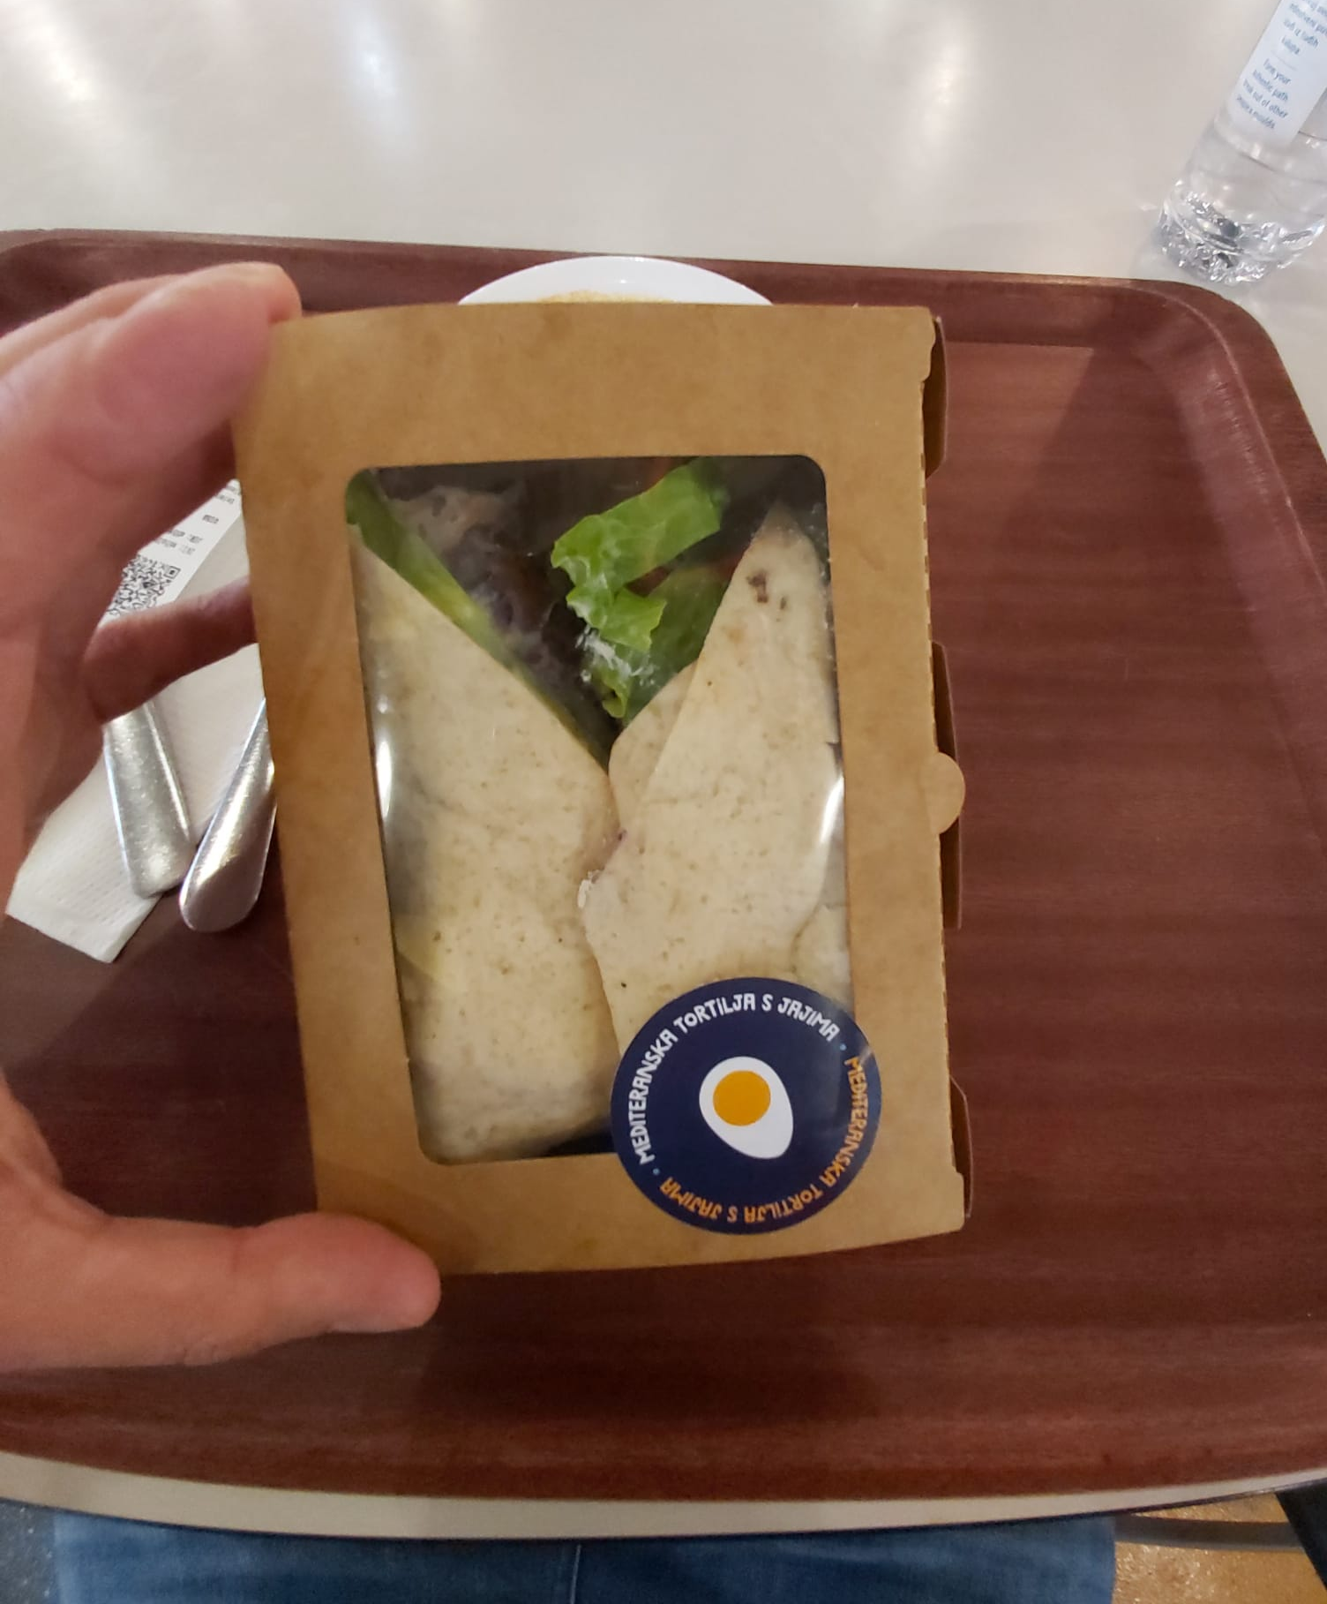
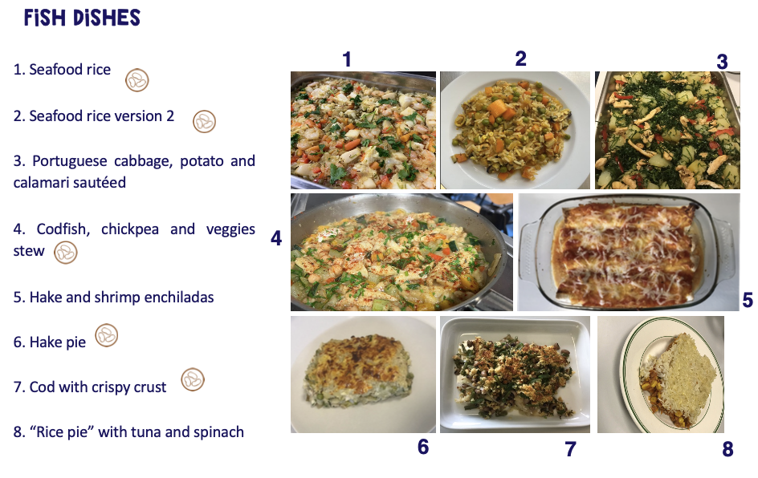
Future work & ideas
5. develop a meal plan framework
6. develop a new “ MD student bag”
7. Develop and use social marketing strategies
Low MedCIn score in TR
Low consumption of seafood vs geographical advantage
6.2 kg/pc/py vs 59 kg in PT and 20.1 in HR
Notes:
Per capita/per year

Slide 46

Future work & ideas
5. develop a meal plan framework
6. develop a new “ MD student bag”
7. Develop and use social marketing strategies
Menu interventions in HEI canteens
Mediterranean diet
projection of a reduction
2.2–23.4% in the carbon footprint
37.5–58.6% in the water footprint in TR
(Aytekin-Sahin, G., Besparmak, A., Sagir, S. S., Somtas, A., & Ozturk, D. (2023). Relationship between nutrient profiles, carbon footprint and water footprint of hospital menus. Nutrition & Food Science, 54(2), 319-333.)

Slide 47


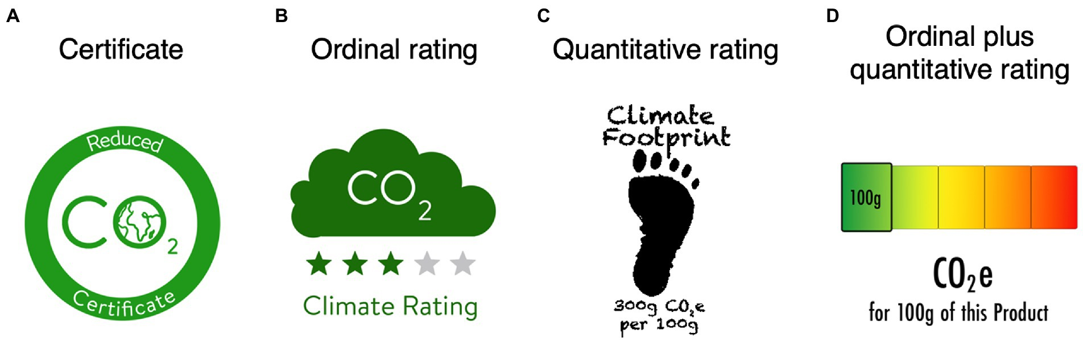
Future work & ideas
7. Develop and use social marketing strategies
Social marketing interventions in HEI canteen
Energy and nutrient values are already available on many menus.
Water and carbon footprints – out of sight, out of mind
Kühne, S. J., Reijnen, E., Laasner Vogt, L., & Baumgartner, M. (2023). Can carbon labels encourage green food choices?. Frontiers in Psychology, 13, 902869.

Slide 48




Future work & ideas
7. Develop and use social marketing strategies
Notes:
MD Menus
MD Student bag
Opinion leaders that can be used to improve motivation:
Young influencers and student ambassadors;
University faculty staff (selected by each university and considering relevance and motivation to the theme);
University influencers with a focus on healthy living, fashion, and lifestyle

Slide 49

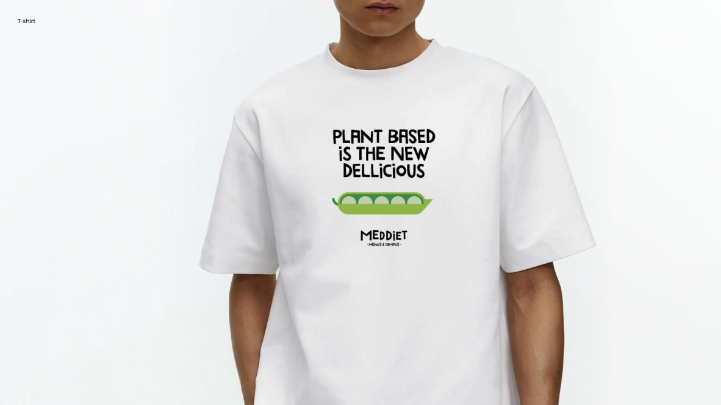
Future work & ideas
7. Develop and use social marketing strategies

Slide 50




Future work & ideas
7. measure the impacts of the implemented strategies
Notes:
The university canteens selected, previously involved in WP1 and WP2, will serve as a pilot for implementing the developed menus and the Student Bag concept, and the staff training is delivered by professionals involved in the menu previously developed.
Meanwhile. the researchers provide support to gather potential implementation challenges and feedback. The evaluation activities are led by ISCTE and include both quantitative and qualitative approaches.
The surveys (n = 200 per country) assess stakeholders’ acceptance and perceived impacts and focus groups with interdisciplinary experts provide insights or the project to improve.
This WP ensures that the intervention is tested, adaptable, and scalable to other food services.

Slide 51
Future work & ideas
Inputs on MedCIn from the team
Improving MedCIn:
  Variety of fruits and pulses
  Other processed foods besides meat products
  Country specific adaptation and validation

Slide 52

Future work & ideas
Creating HEI-specific food service guidelines and regulations
Legislation on university food service, dietitian & students in committee
Including university food service in National Menu Planning and Implementation Guidelines for Institutional Food Services, Ministry of Health, Türkiye
    Basic menu planning principles
    Menu planning principles for:
      Pre-school children
      Schools
      Workplaces
      Workers
      Elderly-care centers
      Children’s Hospital
      Adult Hospitals
      Prisons
      Special days and organisations
Notes:
From national characterization
In Portugal, in terms of food policies related to higher education institutions (HEIs), there is still a need to create more specific legislation and guide documents in this area. However, there are some general recommendations and legislation that can be applied in HEIs.
The most important document of Cratian plicy for students nutrition is the "Pravilnik o uvjetima i načinu ostvarivanja prava na pokriće troškova prehrane studenata" (Regulation on the conditions and procedures for exercising the right to cover the costs of Student Nutrition; issued by the Ministry of Science and Education).

Slide 53
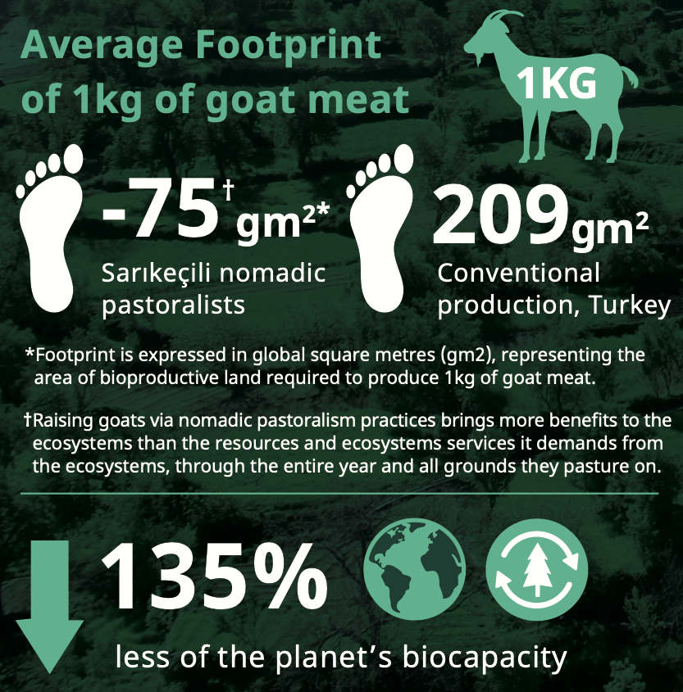

Future work & ideas
Local and sustainable collaborations and solutions
Houzer, E. and Scoones, I. (2021) Are Livestock Always Bad for the Planet? Rethinking the Protein Transition and Climate Change Debate. Brighton: PASTRES.
Wambersie L., Mancini M.S., Galli A., Orhon A., Ateş B., and Yilmaz E., 2023. Ecological Footprint of goat meat from nomadic pastoralist families in Turkey. Report on the work commissioned by the Yolda Initiative within the context of the Foodnected project (2021-2022) funded by MAVA.
Notes:
Türkiye correcte protein requeiremnt: 1.04
Because sources are motly plant-based
TBSA 2010 bir günlük besin tüketim kayıtlarından yararlanılarak hesaplanmış ve DIAAS; lizin için %83 olarak bulunmuştur (52). Yeterli Alım Miktarı bu skora göre düzeltme yapılarak hesaplanmıştır.
Food prices have been rising significantly in Türkiye in recent
Few people can afford meat, especially on student budget
University students with different income levels may view their university canteen lunch as their main source of energy and nutrients, which could increase their expectations.
This might also be reflected in higher canteen usage rates among Turkish students in our study.

Slide 54
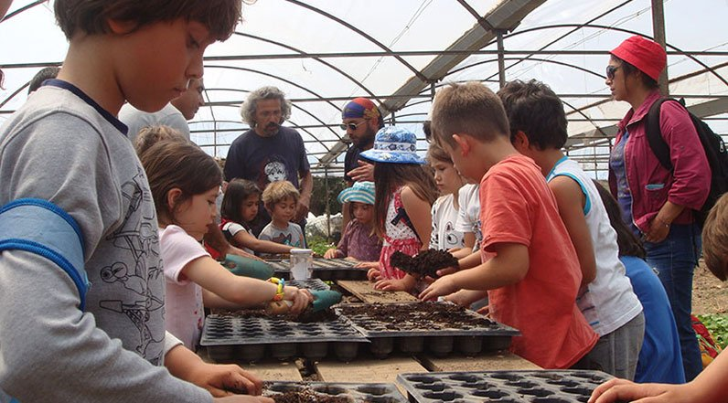
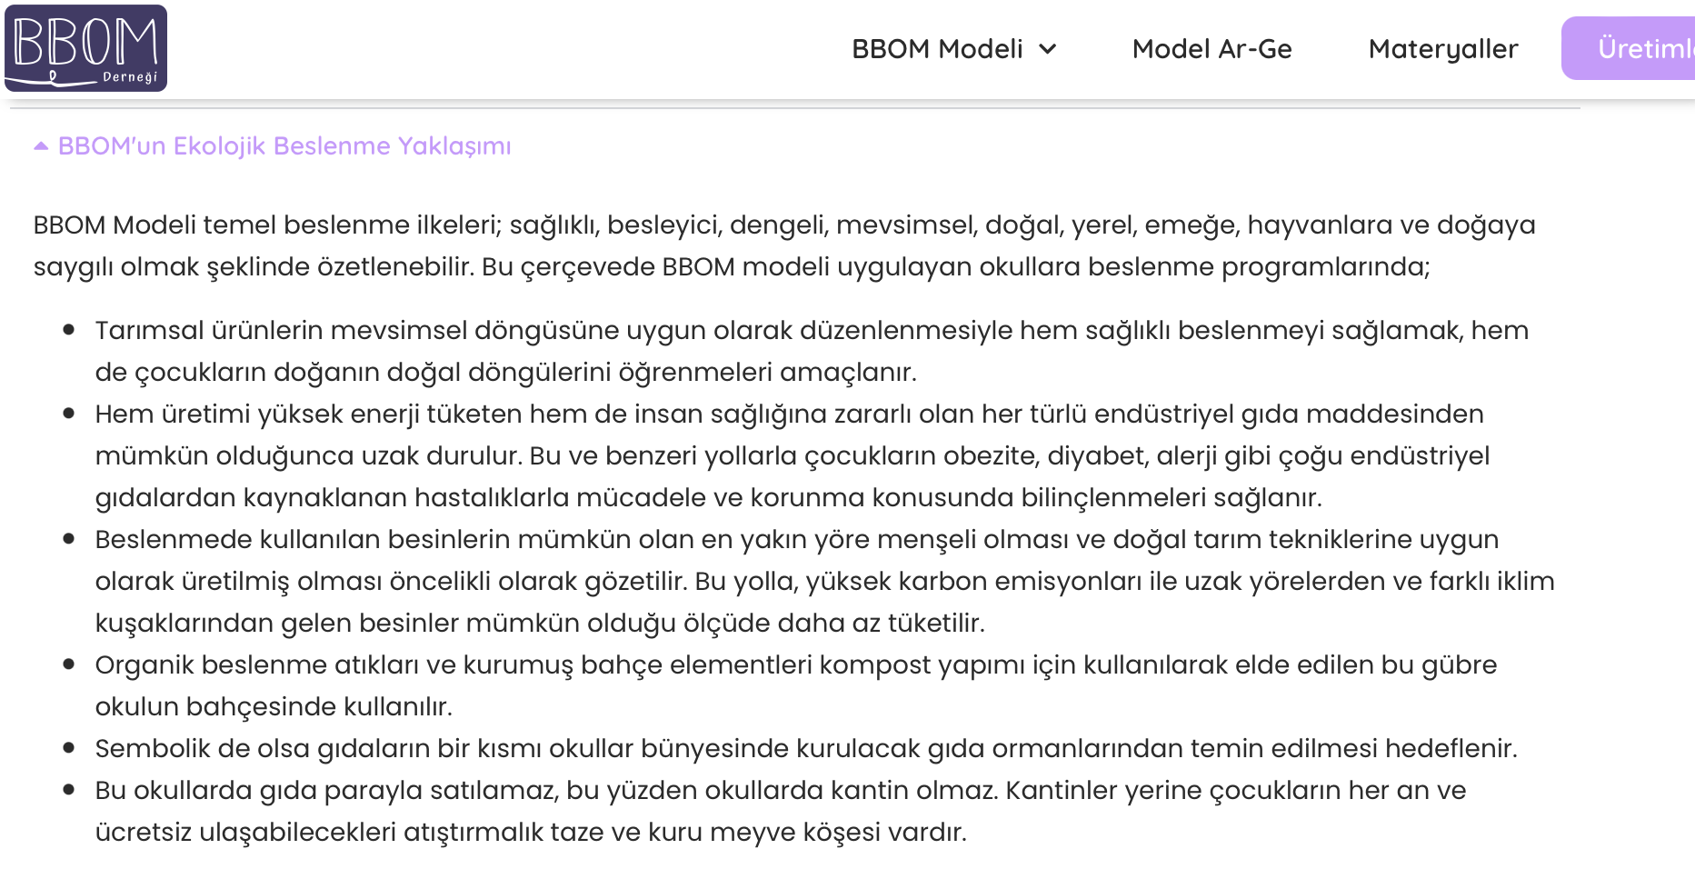
Future work & ideas
Local and sustainable collaborations and solutions

Slide 55
Future work & ideas
Implementing social aspects of MD
Further using social marketing strategies
Serra-Majem, L., Tomaino, L., Dernini, S., Berry, E. M., Lairon, D., Ngo de la Cruz, J., Bach-Faig, A., Donini, L. M., Medina, F.-X., Belahsen, R., Piscopo, S., Capone, R., Aranceta-Bartrina, J., La Vecchia, C., & Trichopoulou, A. (2020). Updating the Mediterranean Diet Pyramid towards Sustainability: Focus on Environmental Concerns. International Journal of Environmental Research and Public Health, 17(23), 8758. https://doi.org/10.3390/ijerph17238758

Slide 56
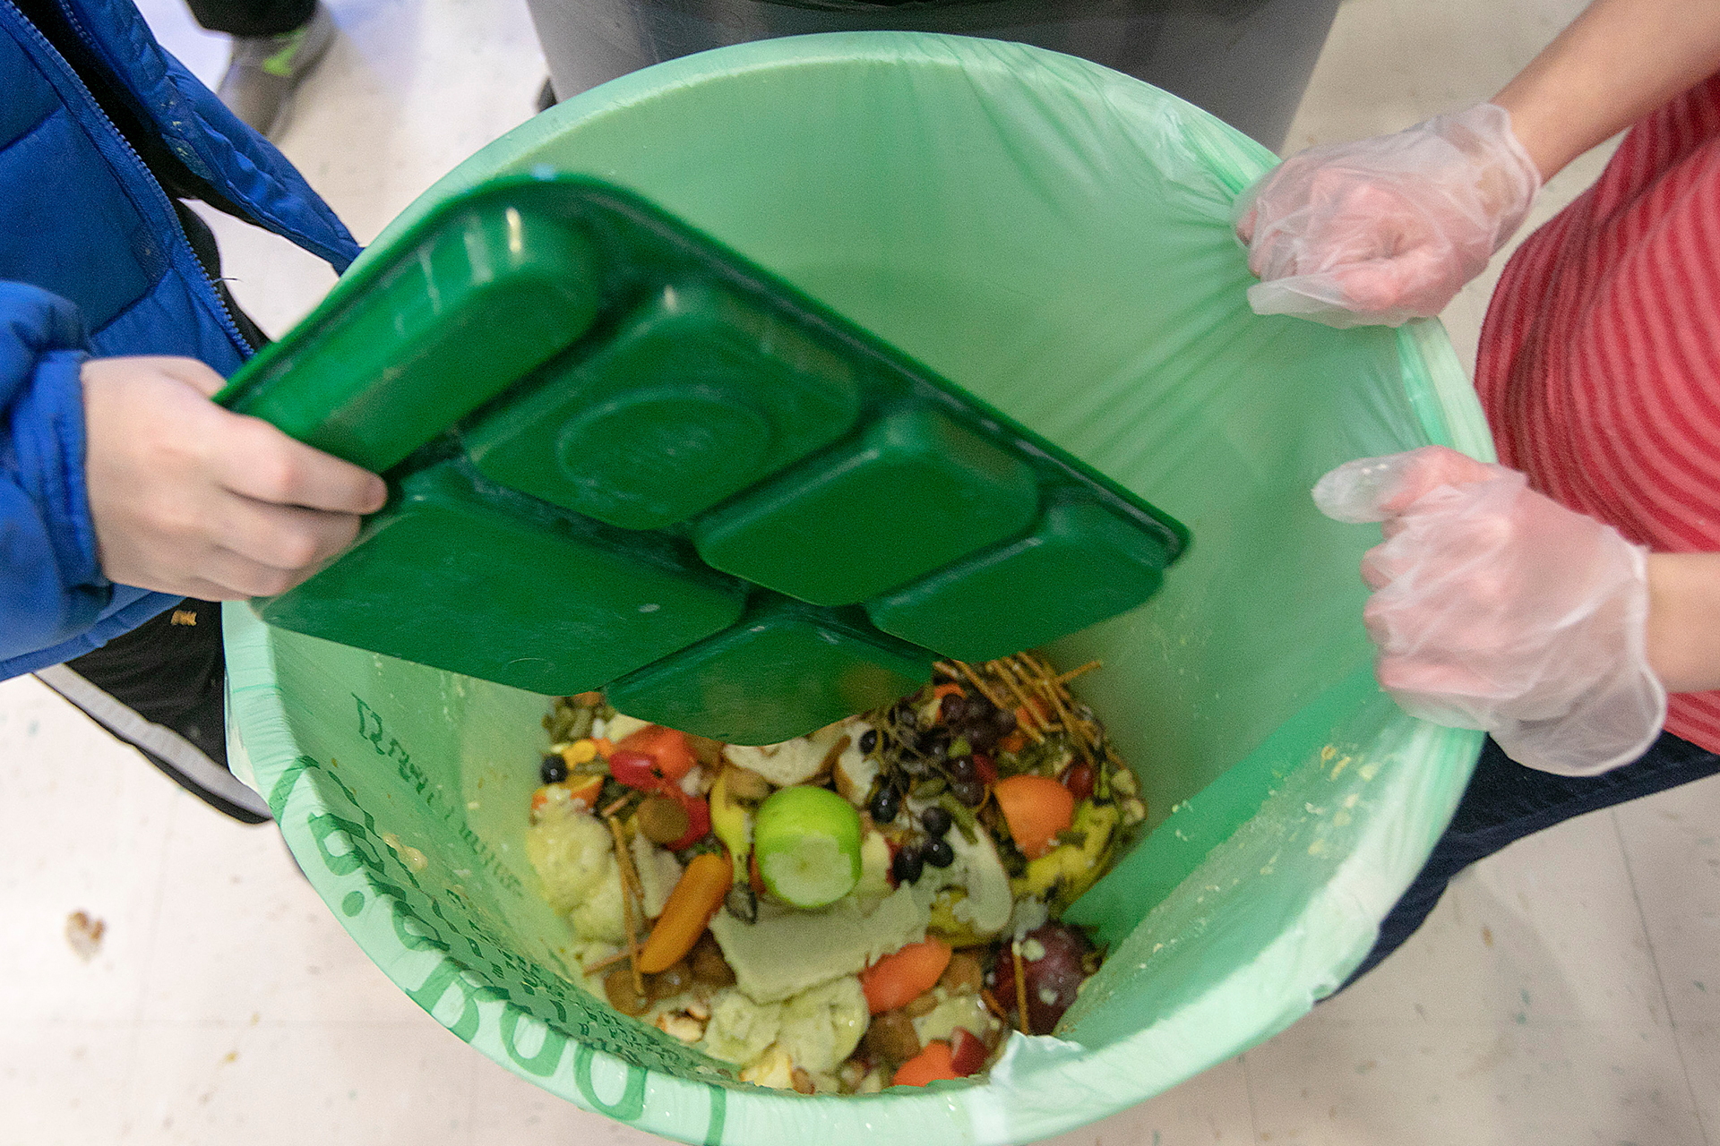
Future work & ideas
Examining the footprint of university food waste
The top two food categories contributing to the total carbon footprint in Chinese universities
Meat waste: 46.28%
Grain waste: 36.52%
Qian, L., Rao, Q., Liu, H., McCarthy, B., Liu, L. X., & Wang, L. (2022). Food waste and associated carbon footprint: evidence from Chinese universities. Ecosystem Health and Sustainability, 8(1), 2130094.

Slide 57
Acknowledgements
This work is financed by national funds through FCT – Foundation for Science and Technology, I.P., under the project «PRIMA/0009/2022

Slide 58
Our team
Thank you!

Slide 59


Project website:

